Slide 1
CRISM
Alberta Health Services
Addiction & Mental Health
June 24, 2016
Barry Andres
Notes:
Slide deck to support SCN planning conversations, including with AHS provincial programs / zones

Slide 2
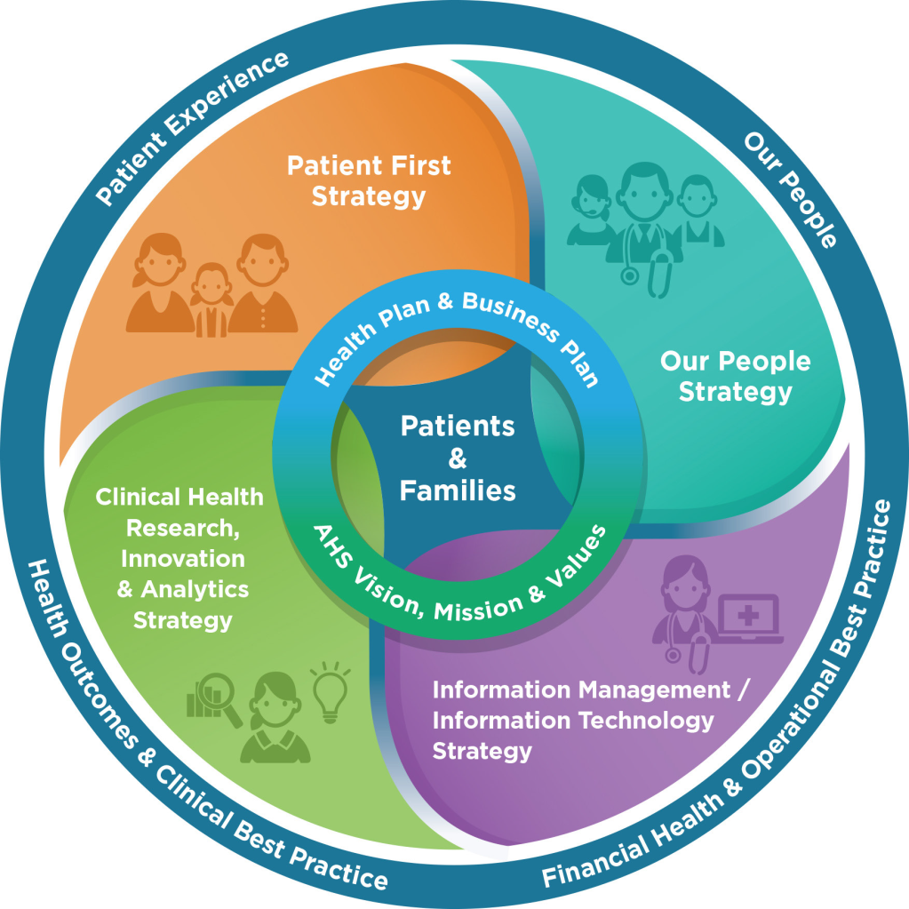
Quadruple AIM – Balanced Scorecard
Notes:
What is a Balanced Scorecard and why we want to link our SCN work to this
Essentially a balanced scorecard (BSC) in a healthcare setting is Triple Aim (current focus) plus a focus on workforce (our people) – this has also been referred to as Quadruple Aim.
AHS is moving to a balanced scorecard approach with planning and performance management for full implementation in April 2017. AHS has already started moving in this direction with the realignment of 2016-17 operational plans into the BSC framework
Each quadrant of BSC reporting is aligned to Quadruple AIM – patient experience, our people, health outcomes, financial health (and the corresponding AHS strategies)
At the centre is patient- and family-centred care
Very deliberate process
Strategic goals and objectives are linked to vision
Measures will directly link to objectives- measures indicate whether objectives are being met - targets are set and in line with activities
Important that our SCN aligns with AHS provincial team and zone operations – work is already underway in AHS to look at how best to do this going forward

Slide 3
What We Want to Achieve – 4 Goals
Patient Experience: Build a culture of patient-, family- and community-centred care to improve patient experience.
Improve patient and population outcomes.
Ensure our people feel safe, healthy and valued.
Achieve financial health through efficiencies and ensuring greatest value for money

Slide 4
What’s on our radar?
Opioid misuse and Fentanyl overdose
Concurrent Capable care
AMH integration in primary care
Trauma Informed care and Disaster Response
Transitions and Navigation of care
Prevention and Community Capacity
Rural and Remote services (telehealth)
Valuing Mental Health

Slide 6
Opioid overdose deaths in Alberta are increasing
Deaths due to an acute drug toxicity with
One or more opioids listed on the ME’s certificate of death
OR
A review of the toxicology database showed one or more opioids present
Year | Edmonton | Calgary | Rural (4) | Total
2011 | 68 | 48 | 97 | 213
2012 | 77 | 69 | 125 | 271
2013 | 68 | 84 | 139 | 291
Notes:
Data from the Office of the Chief Medical Examiner
Overdoses deaths involving opioids are increasing
For comparison, in BC in 2013 the number of deaths from overdose of all drugs, not just opiates, was 279
To put these numbers in perspective, so far this season we have had 77 deaths due to influenza. The number of deaths due to traffic fatalities in 2013 was 358.
http://www.transportation.alberta.ca/Content/docType47/Production/AR2013.pdf

Slide 7
Overdose deaths involving fentanyl are increasing
Year | Edmonton | Calgary | Rural(4) | Total
2011 | 3 | 0 | 3 | 6
2012 | 7 | 6 | 16 | 29
2013 | 12 | 21 | 33 | 66
2014 | 38 | 29 | 53 | 120
2015 | 75 | 90 | 107 | 272
Notes:
Last few years, anecdotally have heard reports of fentanyl masquerading as other street drugs, many times more potent than heroin, results in overdose deaths. These data support that.
BC has also noticed a similar phenomenon with 15 fentanyl related deaths in 2012 and 51 in 2013

Slide 8
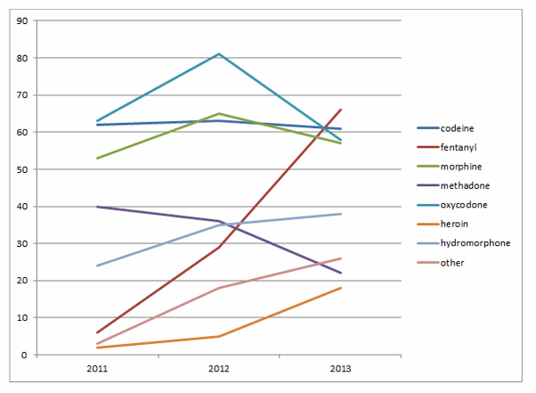
Overdose deaths by Opioid type
2015 – 272 fentanyl OD deaths

Slide 9
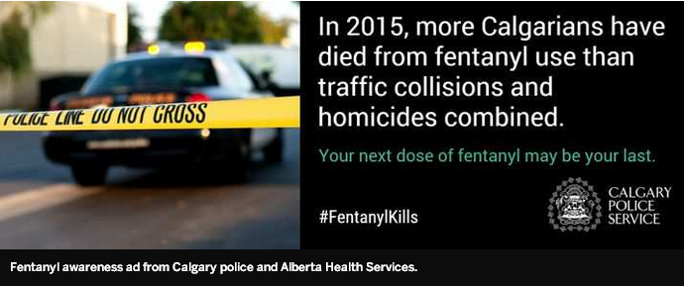
http://calgaryherald.com/news/crime/calgary-man-charged-with-smuggling-fentanyl-from-china

Slide 10
CONCURRANT DISORDERS
In substance abuse settings, the prevalence of mental health disorders is reported to range from 70% to 80%. In mental health settings, estimated prevalence of substance use disorders ranges from 1% to 55% (Puddicombe, Rush, & Bois, 2004).
Individuals with concurrent disorders are more likely to seek services than are those with pure substance dependence and, to a lesser extent, those with pure mood or anxiety disorders (Rush et al., 2008).

Slide 11
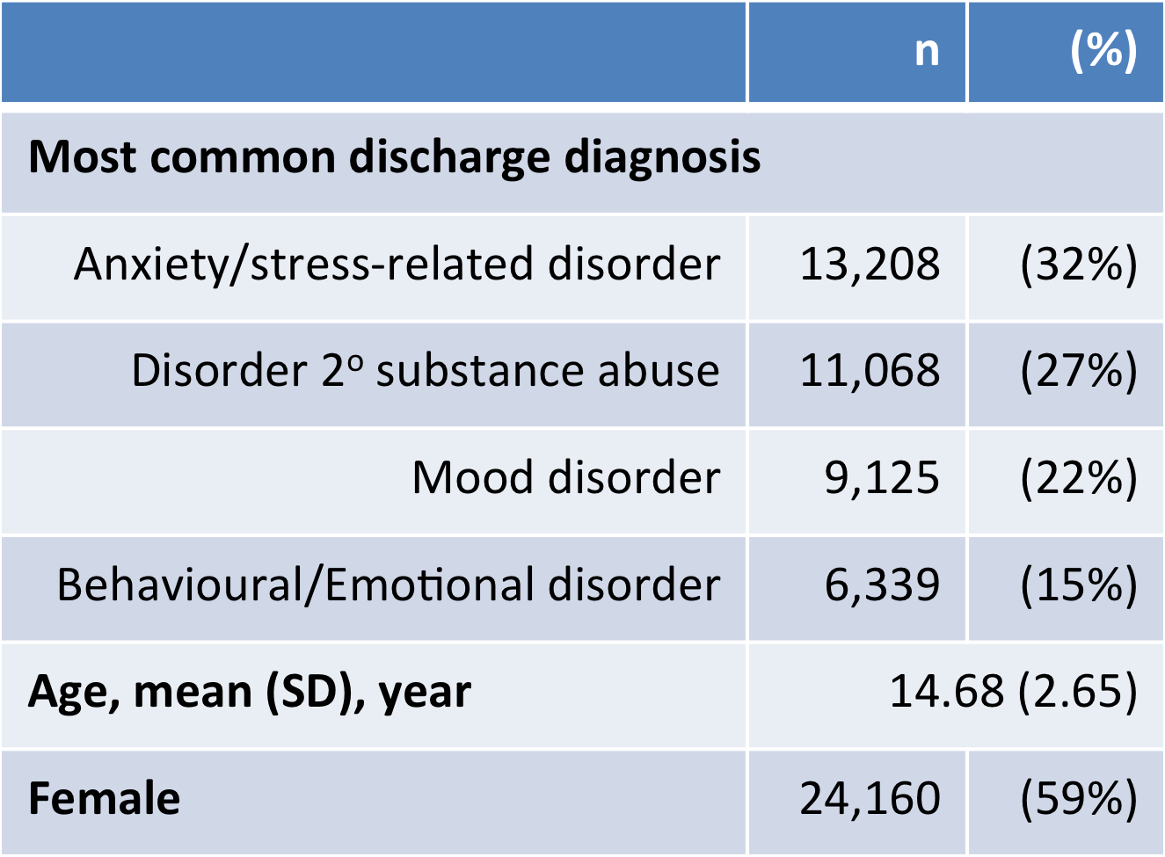
In Alberta from 2002 to 2011…
41,159 visits were made to EDs for child and adolescent mental health emergencies.
Notes:
Disorder 2 to substance abuse = mental and behavioural disorder secondary to substance abuse.

Slide 12
Psychosocial Supports for Disaster Response and Recovery
Slave Lake Fire 2001
Southern Alberta Flood 2013
Fort McMurray Fire 2016

Slide 13
Navigation and Transitions through Care
OAG Recommendation
Valuing Mental Health Recommendation
Accreditation 2016
QAR

Slide 14
Prevention and Community Capacity Building
Alcohol Regulation and Responsibility
Community Response
School Based Supports

Slide 15
Addiction and Mental Health Strategic Focus
Increase community service capacity
Improve quality & safety
Improve transitions and reduce Alternative Level of Care inpatient days
Engage clients in the community
Develop stronger links with Primary Care
Increase and improve needs based service planning
Optimize the workforce

Slide 16
Priority – Opioid Overdose Response
Naloxone Distribution
150 non-pharmacy sites are dispensing naloxone, including 74 sites that accept walk-in clients, dispensing over 500 kits.
660 community pharmacies have also registered as dispensing sites, dispensing 429 kits between January 25 and June 2.
As of May, 2016, AHS had a total of 6000 THN kits to dispense to a total of 810 registered locations.
Emerging Issue: Naloxone Nasal Spray
Opioid Dependency Treatment
Increase treatment availability
Enhance physician supports

Slide 17
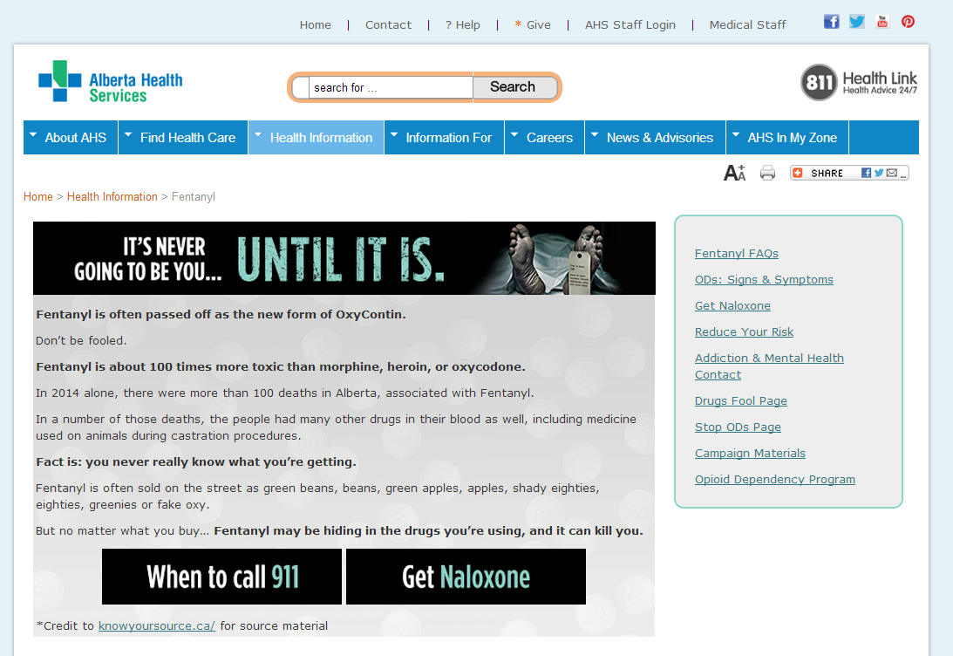
Awareness Campaign
Launched in September, continuing into December

Slide 18
Priority – ODT Access Expansion
Increased number of physicians able to and actively providing ODT
Improved ease of access for ODT patients requiring ODT and AHS psychosocial supports
Increased availability of substitution therapy in Alberta’s primary care environments
Increased availability of ODT in northern and southern Alberta
Increased supports to ODT providers to meet demands and standards of care

Slide 19
Priority - Concurrent Capable Care
Provide concurrent disorder education and supports to addiction & mental health staff
New Workshop Series! A Standard Approach to Concurrent Capable Practice
Concurrent Capable Review Service
Concurrent Capable Competencies
•Concurrent Capable Competency Conversation Tool & Learning Plan
•Behavioural Competency Interview Questions
•Behavioural and Technical Competencies
•New!: Competency Framework and Learning Plan onsite workshop
Concurrent Disorder Learning Series
•Monthly knowledge exchange event featuring subject matter & clinical experts.
•New Delivery! Videos delivered on YouTube and available on Insite. Monthly Q&A via teleconference

Slide 20
Priority - Primary Care
Increase the capacity of primary care to address addiction and mental health needs of clients.
Primary care integration with two PCNs
IN Roads Curriculum and on line training modules
PACES curriculum

Slide 21
Priority – TIC and Disaster Response
Enhance province-wide psychosocial disaster response and recovery supports
Trauma Informed Care training
Psychosocial supports for disaster recovery and response
Psychological First Aid
Skills for Psychological Recovery

Slide 22
Priority – Transition and Navigation
Provide enhanced navigation of Addiction & Mental Health services in Alberta and improve AMH access and transition
Valuing Mental Health Initiative

Slide 23
Priority – Prevention and Community Coalitions
Continue to deliver provincial addiction and mental health promotion and prevention
Support communities by funding 30 community coalitions to implement local promotion and prevention activities under the Alberta Alcohol Strategy.
Ongoing support of community coalitions to reduce alcohol-related harm including webinars, social network discussion forums, formal learning events and individual consultation.
Ongoing promotion and staff support of Canada’s Low-Risk Alcohol Drinking Guidelines.
Development of a collaborative toolkit for post secondary campuses to implement activities that will reduce alcohol-related harm.
Development and dissemination of a series of 10 Alcohol and Health topics to further promote Canada’s Low Risk Alcohol Drinking Guidelines throughout AHS and related health professionals.
Support and partnership with the Alberta Cancer Prevention Legacy Fund (ACPLF) Acute Care Team to address alcohol as a modifiable risk factor for cancer.

Slide 24
Priority – Telehealth
Increase utilization of telemental health
• Development of end user support resources.
• Expansion of service sites.
• Increase clinical services through standardized process.
• Addition of new technology to support TMH.
• Resources and training support to clinicians.
• Administrative supports and evaluation and knowledge transfer.

Slide 25
Valuing Mental Health Recommendations
32 recommendations with sub-recommendations
Most recommendations aimed at the government with AHS and NGO’s as partners
Many appropriate upstream recommendations
All require clear governance and accountability

