Slide 1
Demonstration projects
Cam Wild and David Hodgins
June 23, 2016

Slide 2
Locating CRISM demo projects
The population health pyramid can help us think clearly about how to respond to service gaps
High
Low
High
Problem severity
(acuity, chronicity,
complexity)
Access
specialty
care
Diagnosed
Numbers served
Cost
Meet screening
criteria for problems/
dependence
High
Low
Exposed to risk factors
Low
Healthy population

Slide 3
Traditional health system responses and priorities
Critical, but not enough!
Provide more dedicated
treatment beds or
slots
Specialty
care
Work with primary
health care to
screen and
intervene
Identified/Diagnosed
Meet screening
criteria for problems/
dependence
Exposed to risk factors
Healthy population

Slide 4
Premise of demonstration projects
Address two key system problems
Drop-out rates from addiction
treatment programs are very high
Specialty
care
Identifying substance
misuse in primary care
is problematic
Identified/Diagnosed
Meet screening
criteria for problems/
dependence
Exposed to risk factors
Healthy population

Slide 5
Premise of demonstration projects
Address two key system problems
Demo project 1: Motivating
client engagement in treatment
Specialty
care
Identified/Diagnosed
Demo project 2:
Build capacity for
delivering screening
and brief interventions
directly to communities
Meet screening
criteria for problems/
dependence
Exposed to risk factors
Healthy population

Slide 6
Demonstration project 1
| Prairies
David Hodgins

Slide 7
Demonstration project 1
Motivating client engagement in SM treatment
Objective
Adapt motivational interviewing (MI) and contingency management (CM) interventions to the Canadian treatment context. Goal is to enable more widespread adoption with high levels of fidelity.
Implementation
Sites chosen from across the Prairie region among programs that indicate an interest in addressing issues of motivation and retention within their settings.

Slide 8
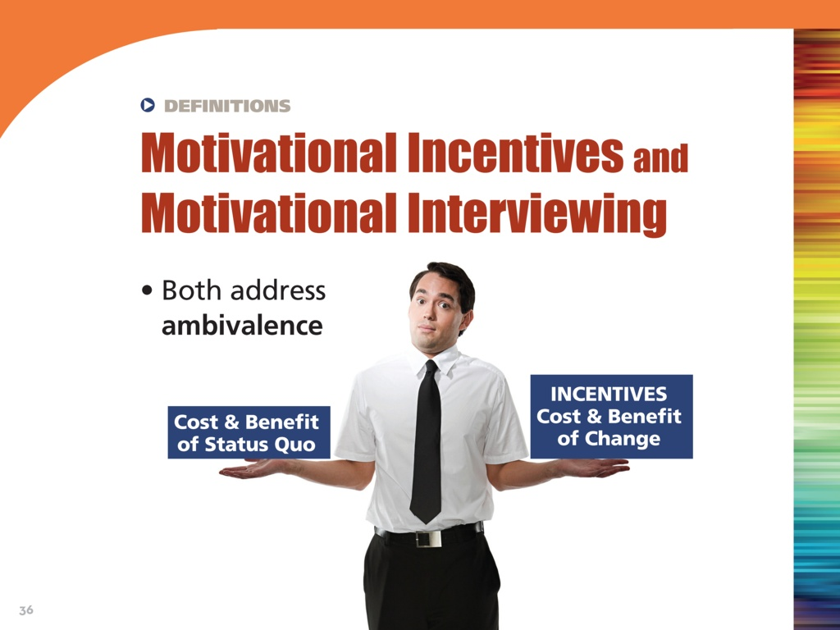

Slide 9
Demonstration project 1
Motivating client engagement in SM treatment
Phase 1 (2016): identify regional sites; work with them to explore how MI and CM techniques and principles could be adapted for implementation into existing programming.
Published training materials (e.g., NIDA Blending Team Products) will be further developed, adapted, and piloted to develop user-friendly protocols, and training and resource needs will be determined.

Slide 10

Promoting Awareness of Motivational Incentives (PAMI)
Motivational Incentives Awareness Video
PowerPoint presentations for clinicians and policy makers
Toolkit (activities, sample materials, etc.)
Resources (bibliography, articles, FAQ, etc.)

Slide 11
First Meeting Discussion
Initiation
wait list
initial assessment
program start
Program
Aftercare

Slide 12
Potential Sites
Henwood
Fresh Start
Aventa
Opioid Dependence Program
Foothills Addiction Centre

Slide 13
Demonstration project 1
Motivating client engagement in SM treatment
Phase 2 (2017-2018): open label prospective trial of the adapted protocols with new program admissions.
A separate trial will be conducted with each treatment site, allowing for staggered start times, and participant accrual over a 6 month period.
Participating programs will be provided with support from Prairie Node research nurses/clinical liaisons, tablets to facilitate efficient data collection, as well as a CM reinforcement budget.
Results used to further refine the training, supervision, and treatment models as well as refinement of training materials.

Slide 14
Demonstration project 2
| Prairies
Cam Wild

Slide 15
Demonstration project 2
Building online capacity for community-based SM screening and brief interventions
Objective
Develop an online screening, self-management, and referral to treatment (SSMRT) platform for SM among youth/young adults.
What’s the concept?
Based on community-based screening, brief intervention, and referral to treatment

Slide 16
Target populations for community-based brief alcohol interventions
Physician-led services are needed but are not always necessary for these target populations, especially at moderate levels of problem severity.
But developmentally, substance misuse typically increases rapidly during adolescence and peaks in young adulthood.
In order to maximize population impact, intervention strategies should ideally target younger people.
Brief self-help interventions have proven in a large body of RCTs to be helpful in reducing alcohol misuse.

Slide 17
One intervention approach:
Personalized assessment feedback
Designed for drinkers in the general population with low-moderate alcohol problems.
Takes advantage of their preference to manage ‘on their own’
Targets alcohol-related norm misperceptions
  Provides customized feedback, based on demographics and self-reported alcohol behaviours
  Large market for this approach. In previous population-based research we found ~70% of problem drinkers expressed interest in receiving self-help materials

Slide 18
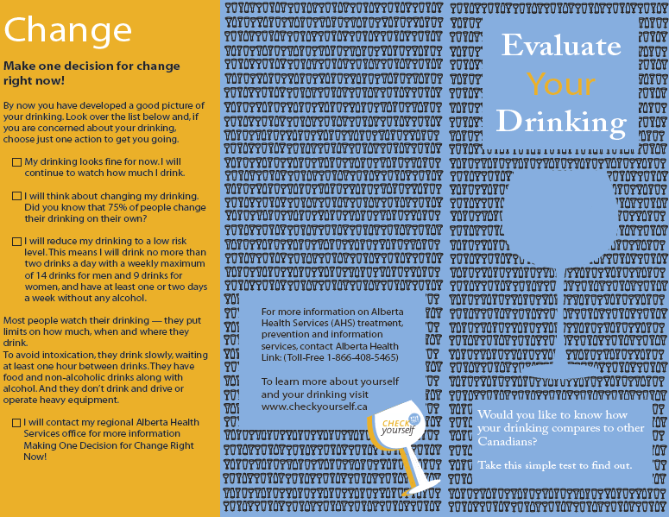
PAF pamphlet (production cost = $1)

Slide 19
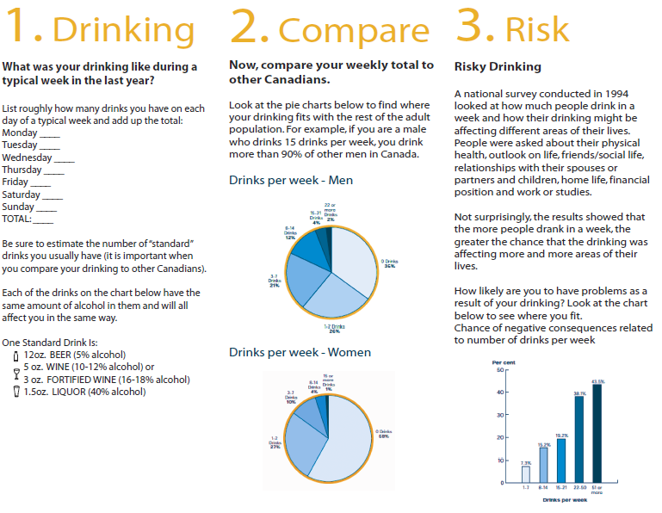
PAF pamphlet (production cost = $1)

Slide 20
6 month follow up results (intention to treat analysis)
Wild, Cunningham, & Roberts (2007). Addiction, 102, 241-250.

Slide 21
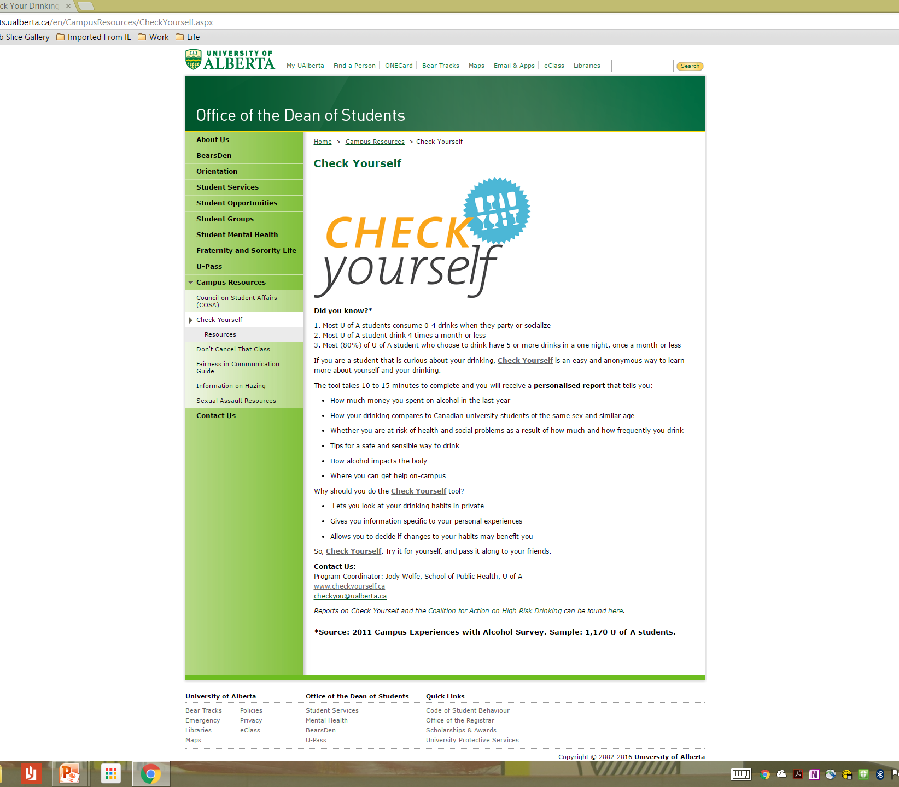
Web-based SBIRT for alcohol misuse

Slide 22
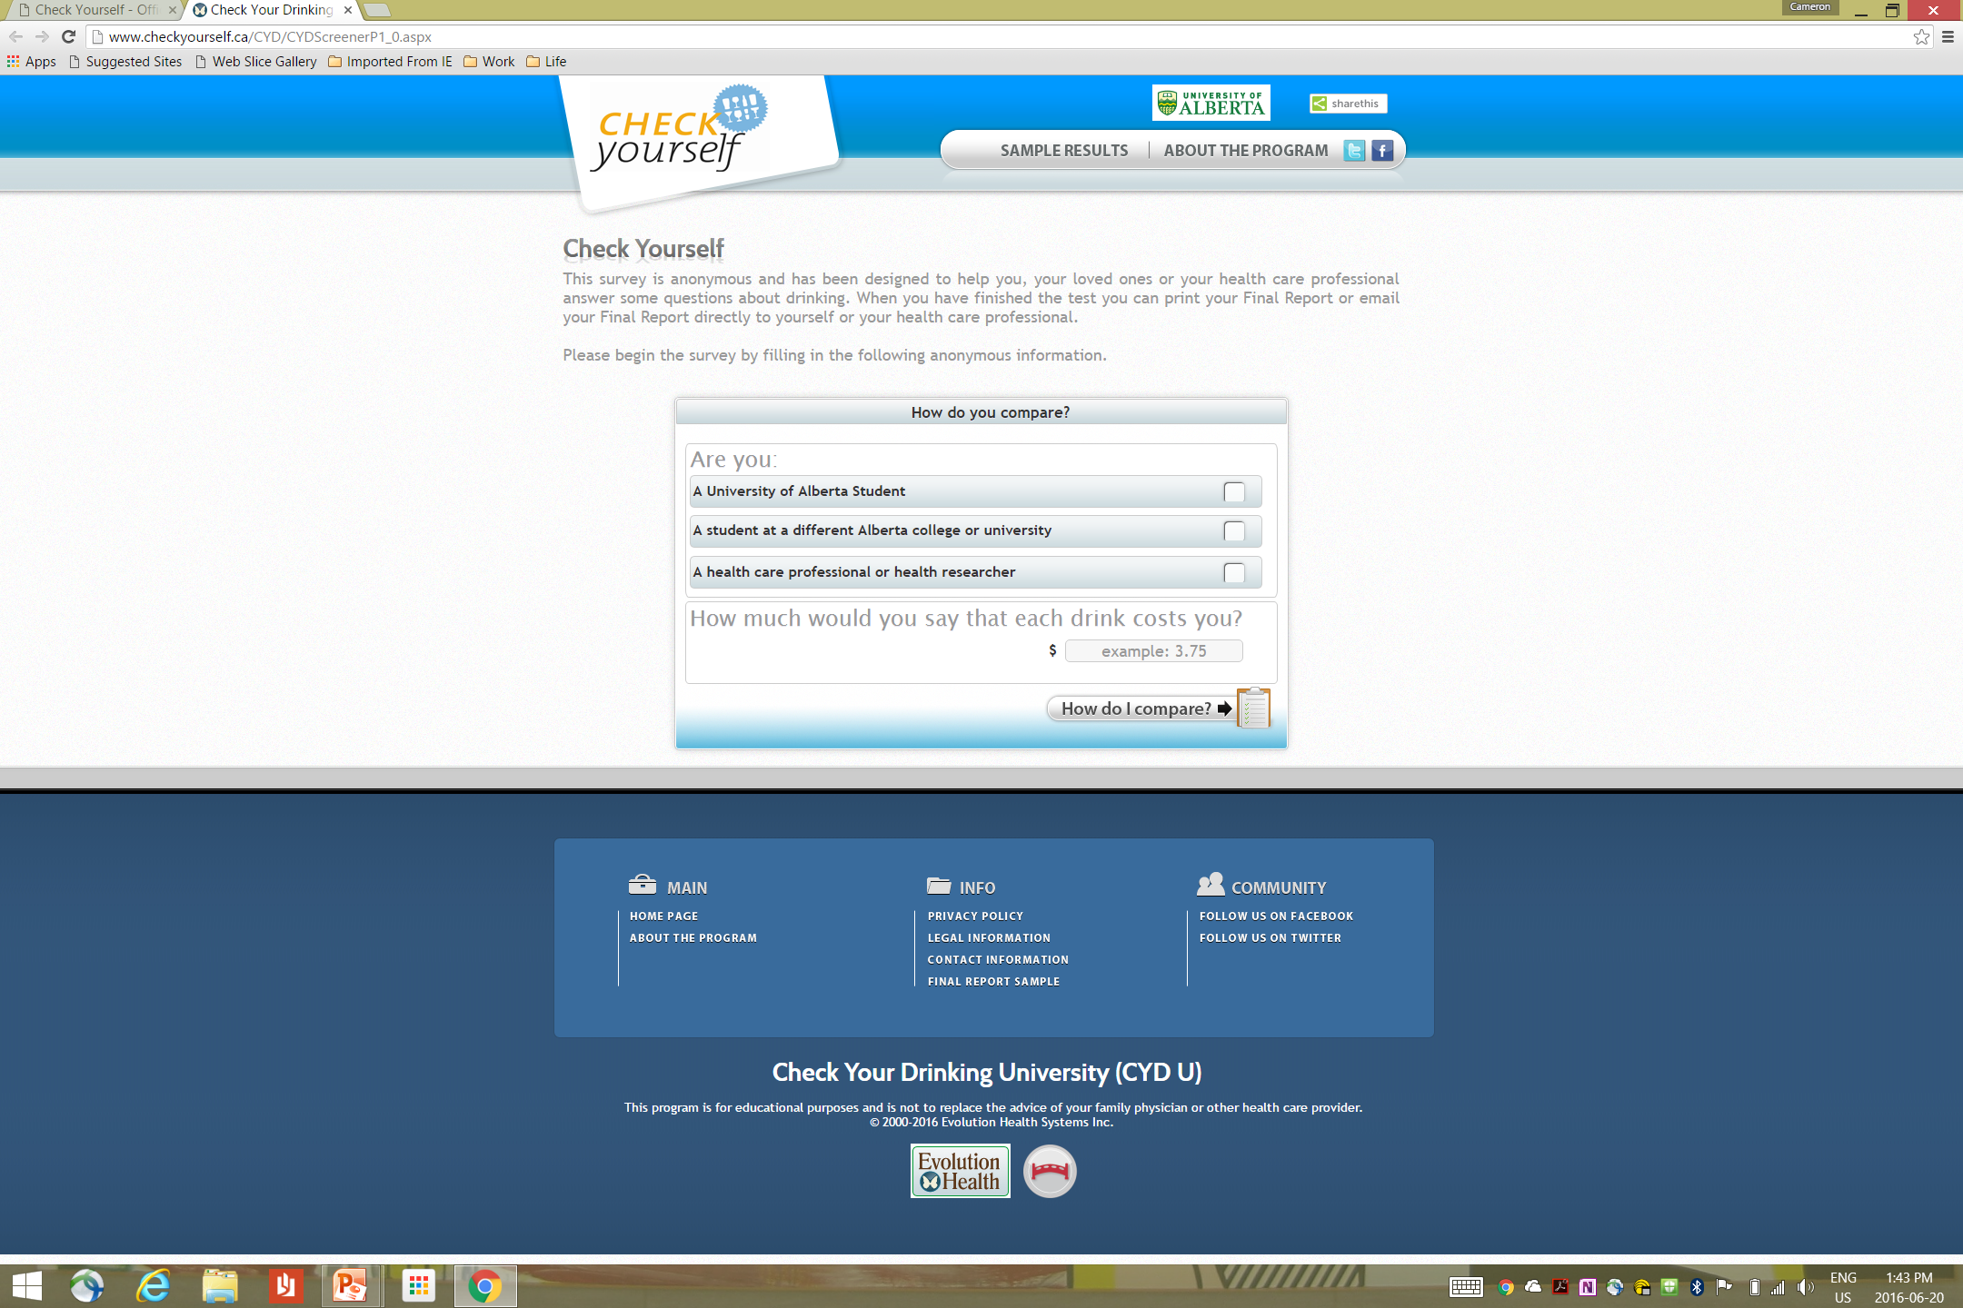

Slide 23
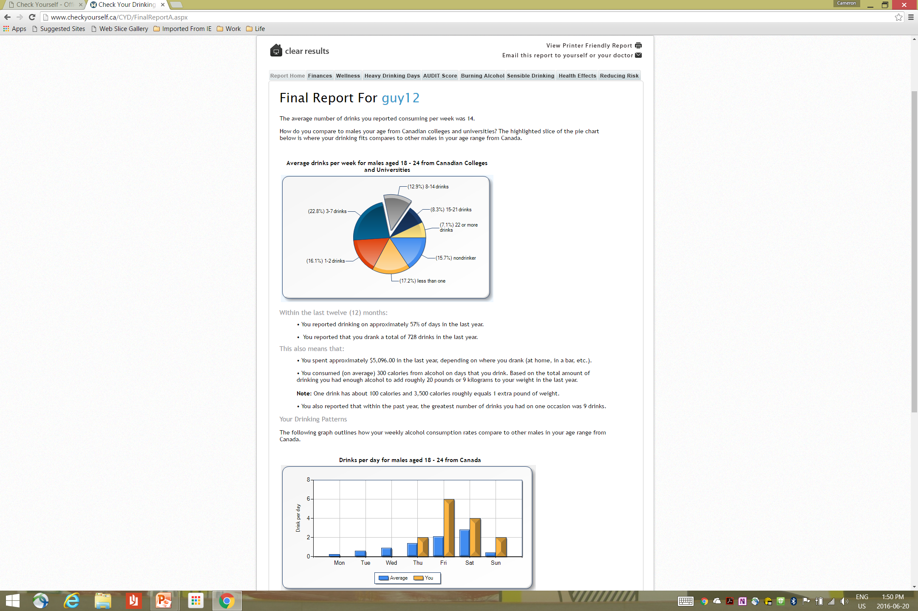

Slide 24
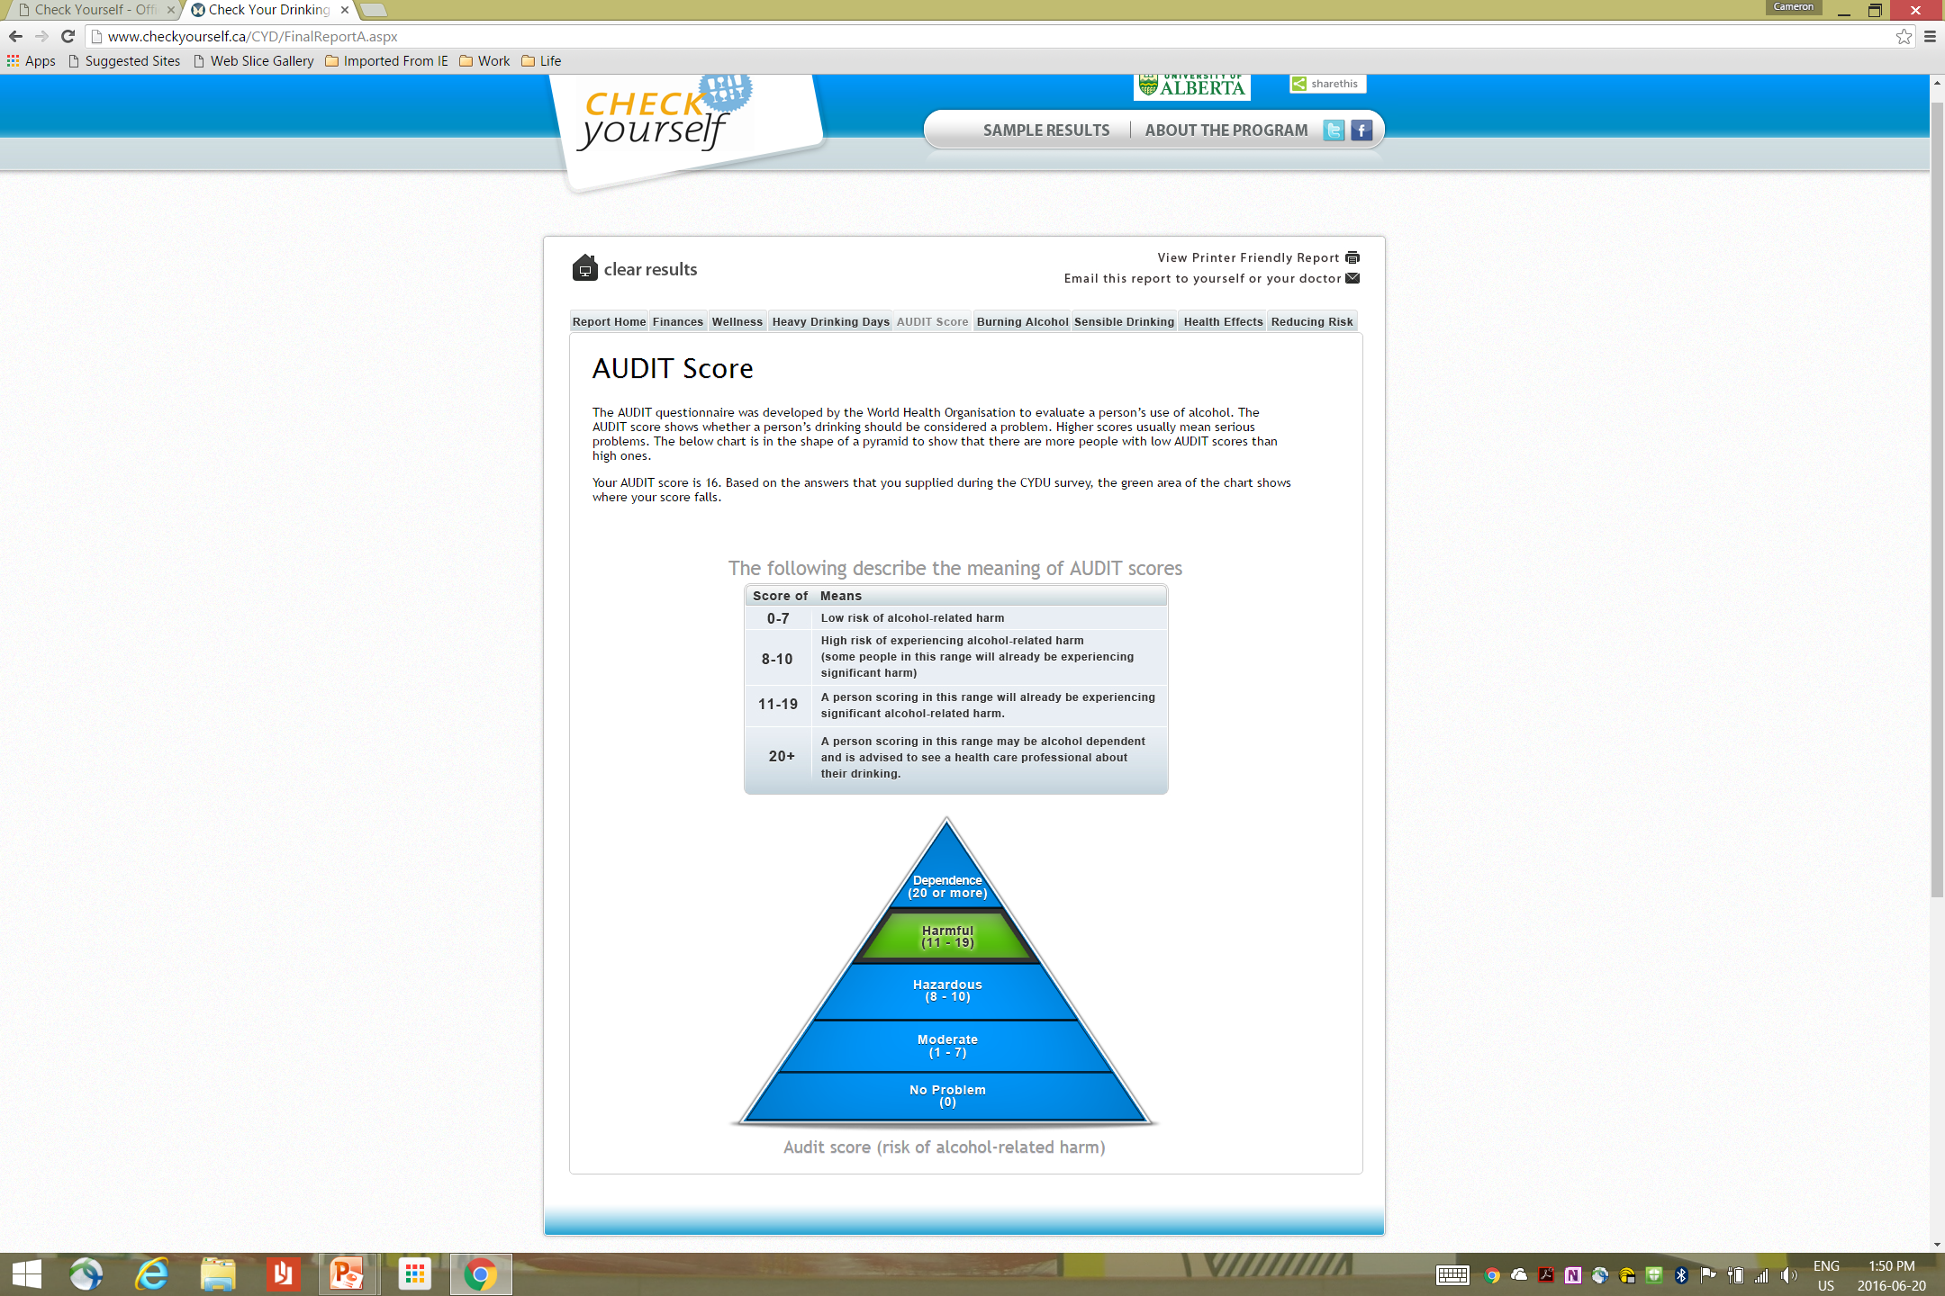

Slide 25
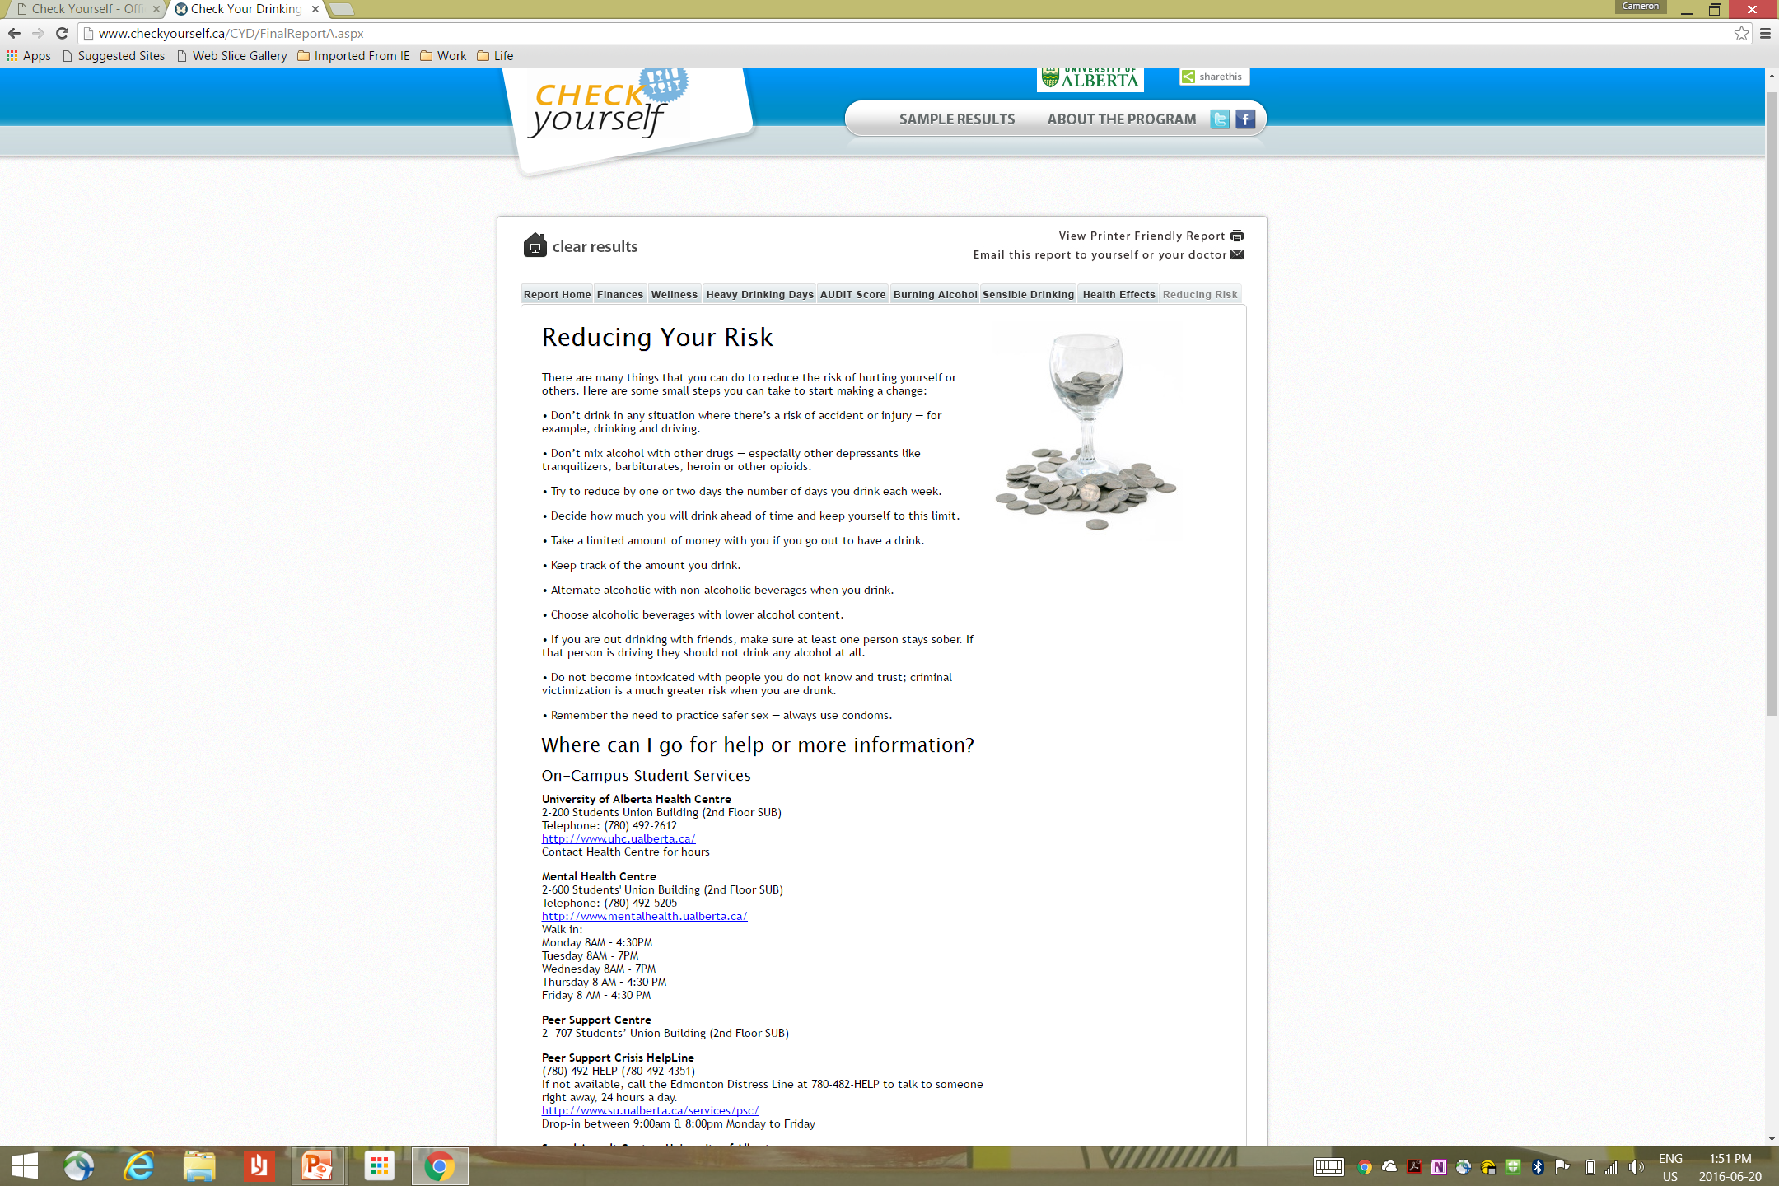

Slide 26
Effectiveness of web-based screening and personalized feedback on graduating high school students
Average drinks per drinking day for 4 study groups of interest
Significant within-person
decrease in alcohol use, p < .05
No within-person
changes in alcohol use, ns

Slide 27
Demonstration project 2
Building online capacity for community-based SM screening and brief interventions
Premise: would the same intervention approach be helpful for other drugs?
Phase 1 (2015-2016): systematic review of brief SM prevention resources that would be suitable for use in a self-directed online format, for adolescents and young adults
Search from inception to November, 2015
Databases (N = 8)
  Medline,
  EMBASE,
  PsychInfo,
  Cochrane SR,
  Cochrane Central,
  CINAHL,
  Web of Science,
  Scopus

Slide 28
Demonstration project 2
Building online capacity for community-based SM screening and brief interventions
Search Terms related to
  Substance use disorder/addiction
  Screening tool or instrument
  Brief intervention
  Limit to non-adult (where possible)
Exclusion criteria
  Not primary data
  Non-English publication
  Treatment seeking or in-treatment populations
Screened by 2 independent reviewers (Kappa >80%)
  Seconding in progress

Slide 29
Demonstration project 2
Building online capacity for community-based SM screening and brief interventions
Results
9905 (unique references)
  Screening of titles and abstracts
    potentially included = 3481
  Included = 2067 primary studies
  Studies coded to date:
    Study Design
      Observational study = 84%
      Experimental study = 16%
    Population of Interest
      Mixed age groups = 80%
      Defined age groups = 20%
        Children (0-11) only = 0.1%
        Youth/adolescents (12-17) only = 12%
        Young adults (18-24) only = 5%
        Adults (25+) only = 3%
Notes:
Approx 40% children, youth, young adults

Slide 30
Demonstration project 2
Building online capacity for community-based SM screening and brief interventions
  Substance of Interest
    Alcohol only = 50%
    Other drugs only = 12%
    Alcohol and drugs = 26%
    Included tobacco = 10%
  Other drugs only
    Child, youth/adolescent and young adult = 89%
      Students = 20%
      Patients = 35%
    Screening only = 80%
    Screening + Brief Intervention = 18%

Slide 31
Demonstration project 2
Building online capacity for community-based SM screening and brief interventions
Tool examples | Name | Target population
DAST | Drug Abuse Screening Test | Youth, Adult
DUDIT | Drug Use Disorders Identification Test | Adult
INDUC | Inventory of Drug Use Consequences | Adult
PESQ | Personal Experiences Screening Questionnaire | Youth
QPM | Questionnaire for Prescription Drug Misuse | Adult
SDS | Severity of Dependence Scale | Youth, Adult
TICS | Two Item Conjoint Screen | Adult
Notes:
Examples of drug-specific screening tools

Slide 32
Demonstration project 2
Building online capacity for community-based SM screening and brief interventions
Phase 2 (2016-2017): collect initial data from youth about feasibility and acceptability of on-line SM screening tools and assess interest in, and preferences for accessing, different types of resources for SM, including information, self-management, and brief interventions.

Slide 33
Demonstration project 2
Building online capacity for community-based SM screening and brief interventions
Phase 3 (2017 – 2019): finalize and test an integrated screening + self-management + referral to treatment online resource.

Slide 34
Demonstration project 2
Building online capacity for community-based SM screening and brief interventions
This meeting: soliciting interested CRISM members to form a working group to take results of the systematic review and move forward to Phases 2 and 3 of this demonstration project

