Slide 1
Canadian Research Initiative in Substance misuse
Four nodes in action: introduction, objectives, progress
Julie Bruneau
Benedikt Fischer
Cam Wild
Evan Wood
NADS Prevention and Treatment Sub-Working Group Meeting
Thursday, September 15th, 2016

Slide 2
Mission and Goals
Build research capacity, collaborations and competitive projects to test and implement evidence-based interventions for drug misuse
Mobilization of researchers and partners
Identification of strengths, needs and opportunities
Building a strong and efficient support platform
Building communication tools and knowledge exchanges

Slide 3
National direction
Built initially on the template of the Clinical Trial Network of NIDA (with Canadian identity)
Position as the consortium of academic, clinical, service providers and community experts on substance misuse
Strengthening research capacity and leverage funds for Addiction intervention research within and outside of CIHR competitions
OPTIMA: First national randomized controlled trial funded through CIHR, designed and run through the network
Translating research findings into guidelines and recommendations at the local and national levels
Role for the network to foster implementation of evidence-based programs and policies

Slide 4
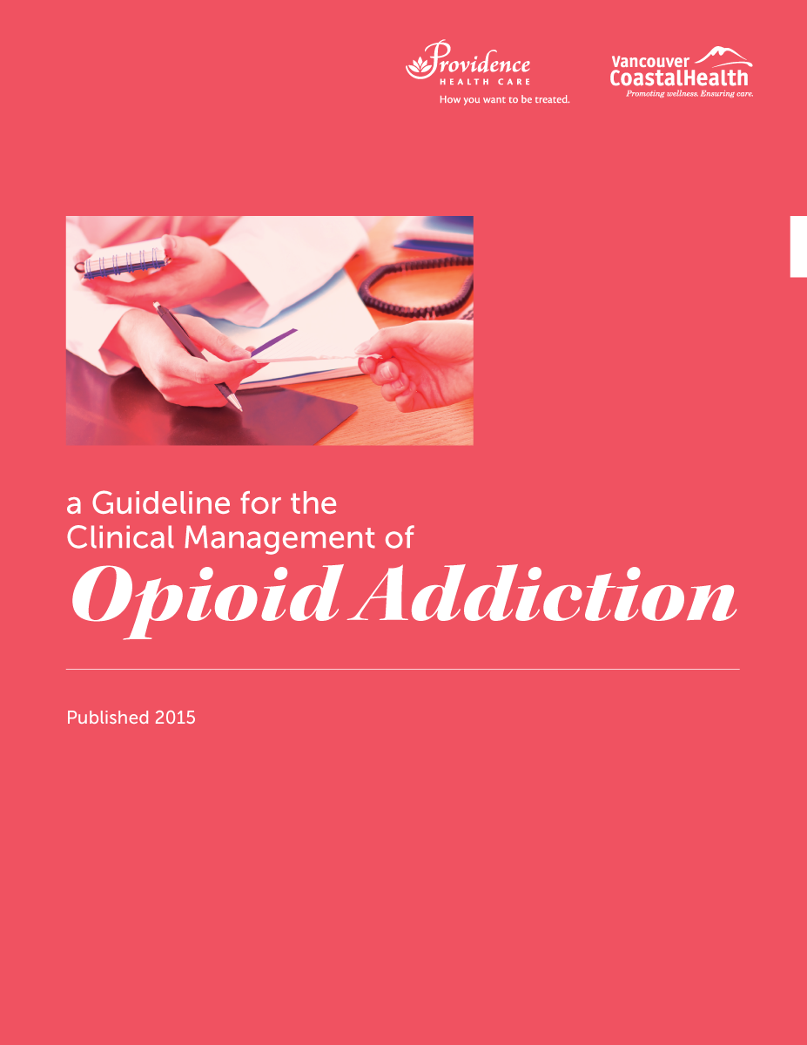
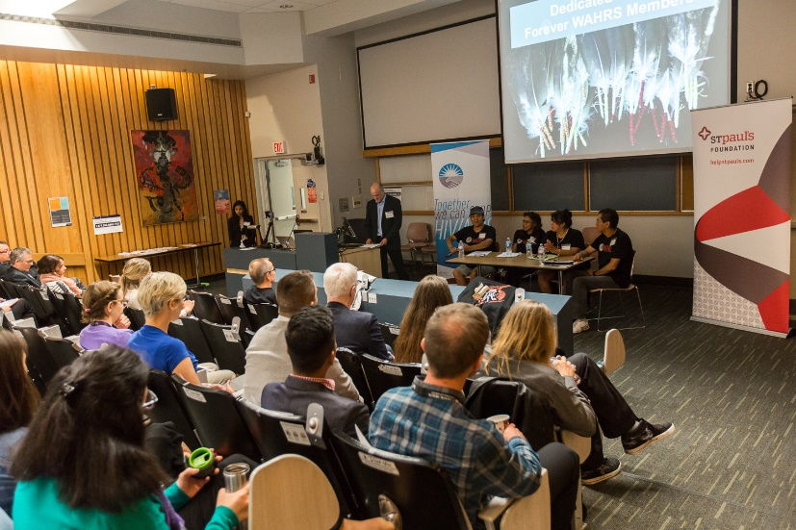
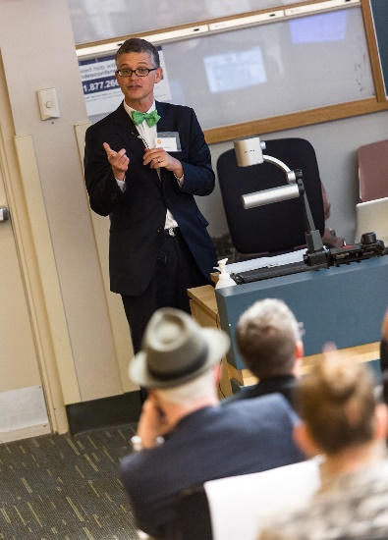
British Columbia node key achievements
Treatment Guidelines and Policy Reports with evidence-based recommendations to address the opioid crisis
BC Addiction Medicine Conference & Research Day (May 2016): >200 attendees, 17 presentations
Notes:
The following has more detail than what Julie will need – so feel free to cut out as much as needed.
In the last year CRISM BC has developed 3 evidence based documents, one of which was a treatment guideline for OUD, and the other two were policy recommendations for better access to treatment and reducing harms of opioid prescriptions. All of these reports were developed through collaborations of the BC node with researchers and service providers. The reports were reviewed by formal committees that included the health authorities and regulatory bodies, and helped to establish CRISM as an authority in evidence based reporting and policy recommendations. They were disseminated widely across the province and garnered much media attention.
Details on the 3 reports:
CRISM BC researchers conducted a systematic review of the evidence for the treatment of opioid use disorder and developed a clinical guideline under the Vancouver Coastal Health (VCH) and Providence Health Care (PHC) Authorities. These guidelines are aimed at improving health professionals’ knowledge of the full spectrum of treatment options for opioid addiction, recognizing that a stepped-care approach is needed to match the varying degrees of addiction severity with appropriate treatment modalities. One key evidence-based recommendation is to use buprenorphine/naloxone (Suboxone®) as a preferred first-line treatment, due to its safer side effect profile and lower risk for overdose.
The rise in prescription opioid use across the province has led to significant harms to patients and substance users, including a dramatic rise in fatal overdoses. To address these concerns, we released a report, “Together, we can do this: Strategies to Address British Columbia’s Prescription Opioid Crisis”, which recommends that clinicians use the provincial prescription monitoring system PharmaNet before prescribing opioids. The report also made other recommendations to limit the amount of opiate prescriptions to help prevent overdose deaths and harms. Some of these recommendations were recently adopted as new regulations from the BC College of Physicians and Surgeons.
Finally, we recently released a report highlighting the safety profile of Suboxone vs. methadone and advocated that this treatment be easier to access. We recommended that the requirement that doctors have a methadone license in order to prescribe Suboxone be removed, and the College did remove this linkage a few months ago.
Last May, CRISM BC held an addiction medicine and research conference, which attracted over 200 people from across BC. The event included many research presentations and a plenary session by Dr. Alex Wally of Boston University. In addition, three peer support groups for people with lived experience presented on their latest research and policy concerns, leading to a lively discussion of the health care needs and challenges faced by the community.

Slide 5
Prairie node key achievements
Collaboration on research focusing on substance use interventions:
2 Demonstration projects:(1) a systematic review of over 3000 scientific publications addressing screening and brief intervention for adolescent substance misuse/addiction, and (2) formation of a working group of 32 researchers and regional treatment programs focused on retention in addiction treatment, and an associated work plan.
Node development funding program : research and KTE sub-grant program, accessible to Node members.
intervention development and knowledge exchange, focusing on couples congruence and animal-assisted interventions.
First annual Node gathering held June 23, 24 2016 in Calgary, AB.

Slide 6
Ontario node (OCRINT) key achievements
Collaboration on research focusing on substance use interventions:
Prescription opioid misuse/treatment
Cannabis disorder treatment and policy/regulation
Naloxone distribution
Facilitation of a 5-year research collaboration between CAMH and Correctional Service Canada for intervention-related research on addiction and mental health in the high-risk corrections population
Development of an intervention use, access and needs assessment among young substance users in several Northern Ontario communities
Update of ‘Lower Risk Cannabis Use Guidelines’

Slide 7
Québec-Maritime node Key achievements
Collaboration on research focusing interventions:
Prescription opioid misuse/treatment ( OPTIMA and ancillary studies)
2 demonstration projects within CRISM QM: 1)Targeted intervention to reduce polysubstance abuse among OST clients in 4 methadone clinics in Montreal and Halifax 2)PROFAN: Prevention and Reduction of Overdoses: Training on, and Access to Naloxone. Naloxone distribution, overdose prevention and user empowerment
Drug misuse and comorbidities
Novel interventions for cocaine dependence with cannabinoids
Implementation of a Research and protocol development program ( RPDP) to encourage leveraging of competitive research protocols and funding
Scaling up a Adolescent intervention program for early prevention (collaboration CTN-NIDA), Drug abuse for MSM, depression in patient with opioid dependence

Slide 8
National Network key achievements
Knowledge exchange contributions at local and national levels; information through social media platforms (twitter, web)
Formal consultation at national, provincial and local levels:
Supervised injection sites
Methadone maintenance treatment review/reform
Overdose prevention and interventions
Legalization of cannabis at the regional and national level
Design, funding and organization of the first CRISM national intervention trial OPTIMA
Work on national guidelines and recommendations

Slide 9
About the Prescription Drug Abuse initiative within CRISM
Optimizing patient centered-care: a pragmatic randomized control trial comparing models of care in the management of prescription opioid misuse (OPTIMA Study)
OPTIMA stems from a research funding opportunity to undertake specific studies in the area of Prescription Drug Abuse within CRISM
The overarching aim of CRISM is to lead to interventions and programs that are proven to be
1) efficacious;
2) tailored to individuals in both their needs and psychosocial context;
3) feasible and applicable in clinical and community intervention settings;
4) more easily accepted by health care and service providers.

Slide 10
About the Prescription Drug Abuse initiative within CRISM (2)
The OPTIMA trial was chosen based on:
The importance of enhancing treatment access and model of care for individuals with prescription opioid disorders, as prioritized in all 4 nodes and during the workshop held in May 2015
Outcomes chosen to address various questions informed by our partners and the community
The possibility to include ancillary studies
A pragmatic approach design with the potential to inform future provincial and federal policies in Canada
Notes:
Not sure this one will be needed as Heather will speak before me

Slide 11
What are the outcome measures?
Primary Outcome Measure
Secondary Outcome Measure
Change in opioid use
Retention in treatment
Change in substance use
Shared decision making
Stabilization
Tapering
Predictors of Treatment Success
Safety

Slide 12
Steps undertaken so far
Protocol and choice of measures
Structure for study coordination, data monitoring and capacity building
Selection of ancillary studies
Selection of DSMB members
Protocol to be submitted imminently to IRB
Timeline for study launch – First patient screened and enrolled in 2016.

Slide 13
Moving forward
Opioid emergency in Canada, yet we have been slow to implement new treatments. OPTIMA Trial provides, for the first time, a national infrastructure for clinical and health services research in substance misuse.
Evidence-based National Opioid prescription guidelines.
Evidence-based Safer cannabis use guidelines
Moving the intervention science and implementation agenda for better prevention and care in substance misuse in Canada

Slide 14
Thank you!
British Columbia Node
NPI: Evan Wood
Node manager: Nirupa Goel
OPTIMA RPI: Maria Eugenia Socias
OPTIMA RPI: Keith Ahamad
OPTIMA CRC: Jill Fikowski
Prairie Node
NPI: Cameron Wild
Node manager: Denise Adams
OPTIMA RPI: Ronald TH Lim
OPTIMA CRC: Denise Adams
Ontario node
NPI: Benedikt Fisher
Node manager: Sarah Miles
OPTIMA RPI: Bernard Le Foll
OPTIMA CRC: José Trigo
Quebec-Maritime Node
NPI: Julie Bruneau
Node manager: Aïssata Sako
OPTIMA RPI: Didier Jutras-Aswad
OPTIMA CRC: Pamela Lachance-Touchette/ Stephen Nyase
OPTIMA National Research Coordinator: Brigitte Desjardins

