Slide 1


National Guidelines for the Clinical Management of Opioid Use Disorder
Lignes directrices Nationales sur la prise en charge clinique de la dépendance aux opioïdes
Dr Ginette Poulin, RD, MD, CCFP, CISAM, CMCBT

Slide 2

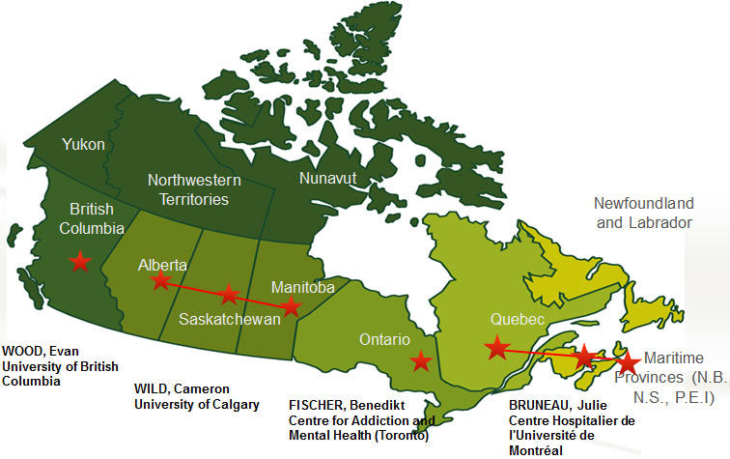
Canadian Institute of Health Research (CIHR)
Canadian Research Initiative in Substance Misuse (CRISM)
Mission: to translate the best scientific evidence into clinical practice and policy change
Notes:
The Canadian Institutes of Health Research (CIHR) is Canada’s federal funding agency for health research. Composed of 13 Institutes, we collaborate with partners and researchers to support the discoveries and innovations that improve our health and strengthen our health care system.

Slide 3

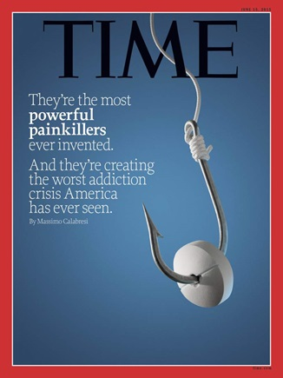

Notes:
CRISM, as a national network on substance misuse, CRISM’s broad and interdisciplinary national network well positioned to move knowledge into practice and has a role in responding to the national opioid crisis.
Approached by Health Canada regarding potential to create a national guideline
We undertook a collaborative effort with structured searches to create a document with a national perspective. Using BC guidelines as a framework, we undertook a collaborative effort to update the literature review with structured searches and adapt the document with a national perspective (e.g., appendices, National background).
The guideline will provide a national context of the opioid crisis and national treatment strategies We leveraged the CRISM national network for consultation, review, and implementation. Leverage the CRISM national network for consultation, review, and to provide an evidence-based document to move the agenda forward at the provincial and territorial levels.

Slide 4



Purpose and Scope
Identify best practices for the treatment of Opiate Use Disorder
Serve as an educational tool and clinical practice recommendations
Inform policy and program planning and development
Promote standardization and consistency in medical care across Canada
NOTE: The scope is limited to OUD oral treatments in the general adult and youth population.
Notes:
Identify best practices for the treatment of OUD, based on current scientific evidence
Provide an overview of interventions and recommendations for their use
Provide resources and additional information to help providers in their practice
To promote standardization and consistency in medical care across Canada, to ultimately improve patient outcomes
The following considerations are beyond the scope of the current guideline but is planned as part of a national group of interest:
Recommendations for specific populations (e.g., elderly, indigenous populations, pregnant women, and incarcerated individuals)
Other interventions (e.g. psychosocial interventions, injectable OAT)
Screening and Diagnosis

Slide 5
CRISM National
OUD Guidelines

Slide 6




Methods
Structured Literature Review
Medically-assisted withdrawal management (detoxification)
Residential treatment
Long-term opioid agonist therapy
Opioid antagonist medications
Psychosocial treatment interventions and supports including peer-based mutual support groups
Harm reduction programs and services
International standards for transparent, high-quality, rigorous clinical guidelines
Notes:
Medically-assisted withdrawal management (i.e., detoxification) and referral to outpatient and/or residential treatment;
Residential treatment;
Long-term opioid agonist therapy such as buprenorphine/naloxone, methadone, and, under special circumstances, slow-release oral morphine;
Opioid antagonist medications such as oral naltrexone;
Psychosocial treatment interventions and supports provided in conjunction with withdrawal management or opioid agonist treatment programs, including peer-based mutual support groups;
Harm reduction programs and services, such as take-home naloxone, supervised injection or consumption services, and needle and syringe distribution programs.

Slide 7

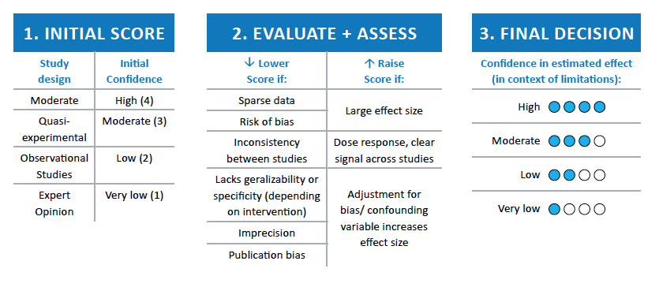
Notes:
QUALITY OF EVIDENCE
-hierarchy of evidence – meta-analyses and RCTs are ranked high
-adjust score - strengths/limitations, methods, clear treatment effect across studies, bias/confounders etc
=FINAL score -> confidence that treatment effect is real and will not change with further research
For strength of recommendation
STRONG – most if not all patients would benefit from this approach, all patients should be offered this treatment
WEAK – some patients may benefit from this approach

Slide 8
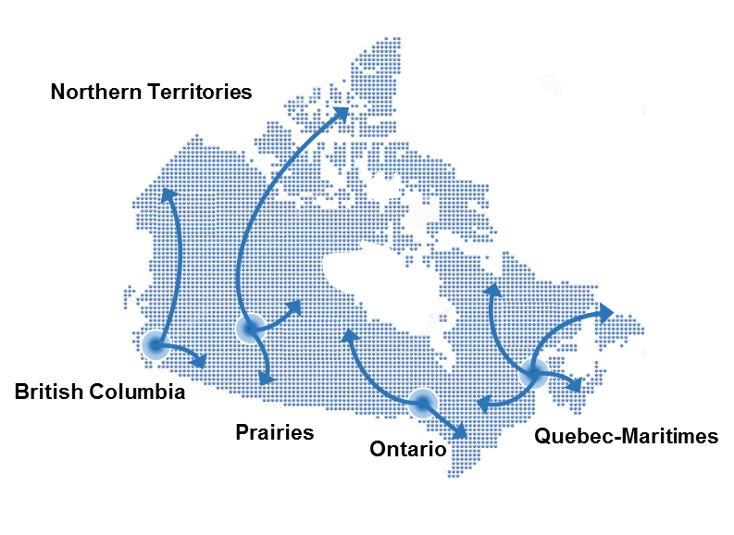
Consultation and Review Process
Regional Committees Formed
2 Rounds of Review
External Review
Final Review and Approval
October 2016 –
February 2017
February – June, 2017
April – May 2017
July - October, 2017
CCSA:
Issues of Substance
2017
Notes:
44 experts across 4 Nodes
with clinical leads
1) BC
2) Prairies and NWT
3) ON
4) QC and Maritimes
External Reviewers - International experts (2)
Canadian Association of People who Use Drugs (3)
moms united and mandated to saving the lives of Drug Users (9)

Slide 9



Consultation and Review Process
Share guidelines with committees
3 weeks to review, submit feedback
ROUND 1
Revisions
COMMITTEE
Share guidelines with committees
2 weeks to review, submit feedback
ROUND 2
Revisions
Final approval from committees + external reviewers
Share guidelines with external reviewers
3 weeks to review, submit feedback
Final approval NPIs
Revisions
EXTERNAL
Notes:
In addition to summarizing the current evidence review, we have also privileged a multi-round clinical review process to incorportate nationwide clinical expertise in addiction.
Briefly there will be 2 rounds of review within the country followed by an external review at the international level.
I will describe the committe review process in more details in little bit, but first lets look at the document’s content .

Slide 10

1. Introduction
Background
Methodology
Summary of recommendations
2. Literature Review
Opioid agonist treatments Methadone Buprenorphine/naloxone | Slow release oral morphine
Withdrawal Management and other Pharmacological approaches Agonist taper Antagonist Treatment | Alpha2-adrenergic agonists Emerging therapies (iOAT)
Psychosocial treatment and Peer-based Support
Residential treatment
Considerations for pregnant women
3. Appendices
Summary of provincial educational and training requirements for prescribing methadone for OUD
Provincial MMT dosing standards
Provincial standards for physician visits, UDT, and take-home dosing
Summary of provincial educational and training requirements for prescribing buprenorphine/naloxone
Summary of provincial regulations for buprenorphine/naloxone administration
Provincial standards for physician visits, UDT, and take-home dosing For buprenorphine/naloxone

Slide 11
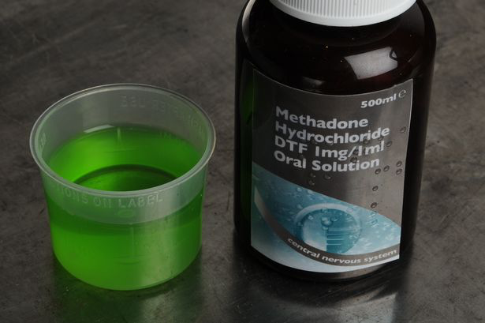
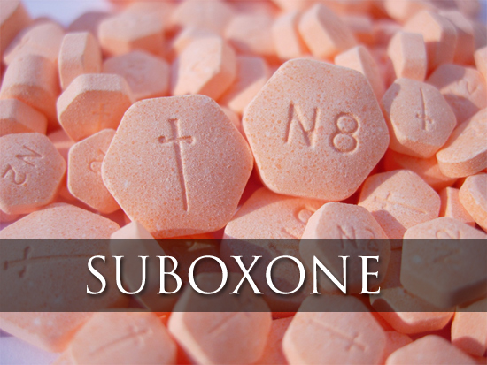
Methadone
Notes:
Extensive comparison between Methadone and Suboxone
Here are some of the Advantages and Disadvantages

Slide 12
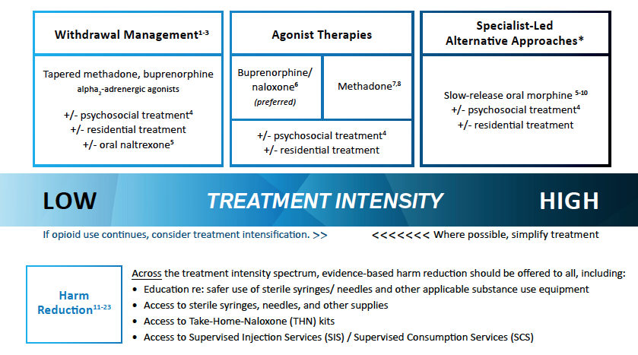
Covered Approaches

Slide 13
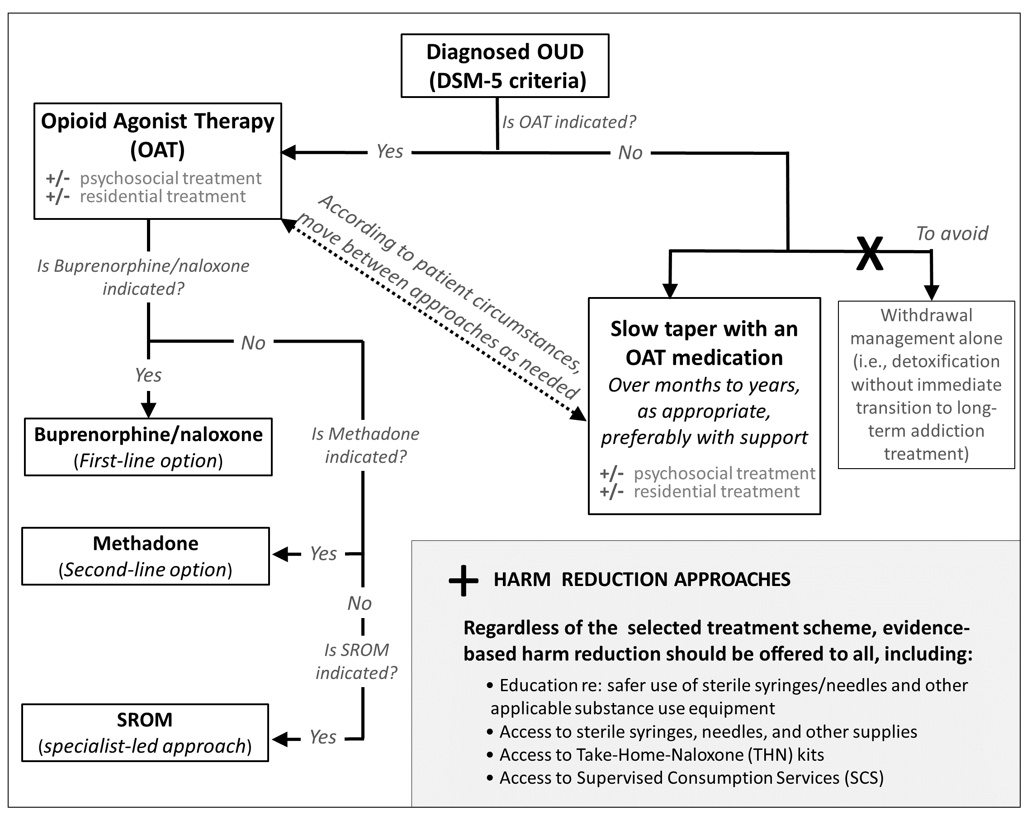
Key Recommendations
Notes:
Note: Important to educate patient re: Safety concerns with OAT taper (shared with patient)
Slow taper considering patient autonomy

Slide 14
Next Steps:
Dissemination and Implementation
Public release with CMAJ publication; media strategy
Letter to stakeholders (e.g. regulatory bodies)
CIHR/HC Knowledge Exchange Event – November 16, Calgary
KT materials (summary card, detox bulletin, Suboxone info)
Node-specific dissemination activities and national activities linked to emerging threat funding

Slide 15
Thank you!
CRISM
http://www.cihr-irsc.gc.ca/e/44597.html
Dr Ginette Poulin
dr.gpoulin@afm.mb.ca

