Slide 1
Partnerships
Principles to inform Research
Presented by: Carol Hopkins, Executive Director,
Thunderbird Partnership Foundation
Addressing Substance Use and Mental Health Issues Among First Nations

Slide 2
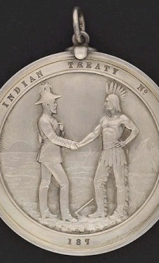
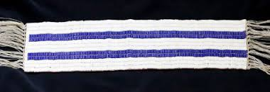
Historical Foundation & Current Context
Treaties set the fundamental principles of the RELATIONSHIP
Culture based expressions of governance support an understanding of the worldview/approach
Two-row wampum
Covenant chain
Constitution Act – inclusion of section 35
Contains the “promise” of recognition of First Nation jurisdiction
Constitution is now supreme to all other laws including Indian Act –and the federal 91- 24 powers
Ontario Government – Political Accord with First Nations
Federal Government commitment to the UN Declaration on the Rights of Indigenous People
Government commitment to Reconciliation

Slide 3
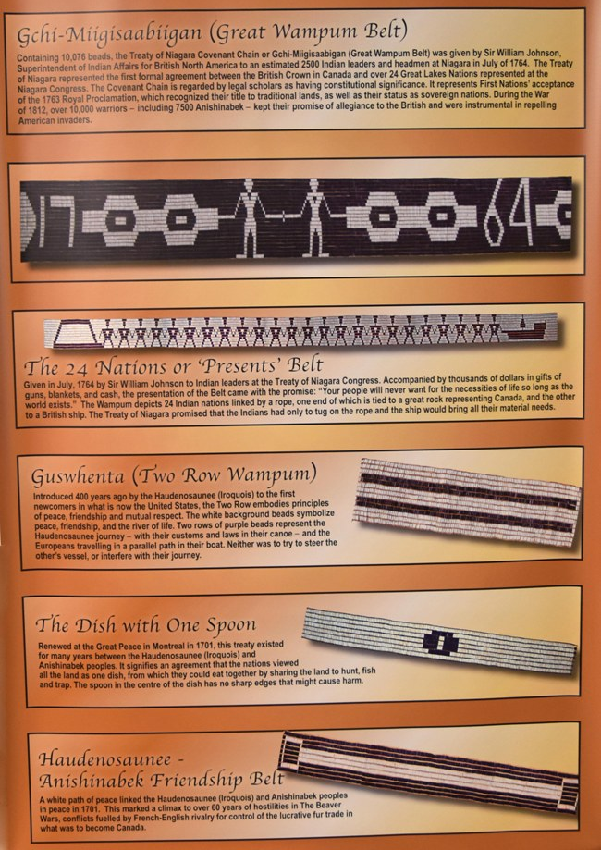
Governance Traditions
DISTINCT SYSTEMS OF GOVERNANCE
WITH CLEAR FRAMEWORK FOR CONNECTION TO INFORM/LEARN FROM THE OTHER
THE CENTER OF THE TWO ROWS IS THE PLACE OF CONNECTION

Slide 4
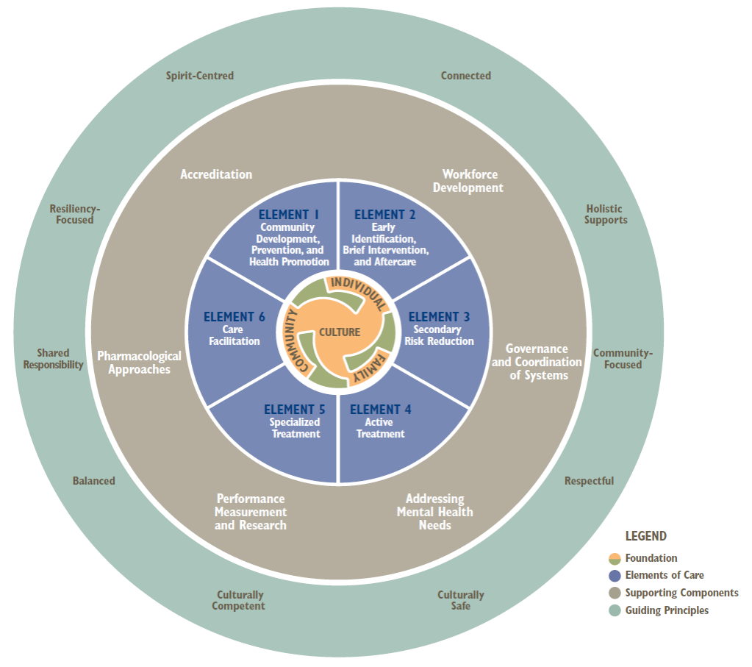
Honouring Our Strengths Systems Model
10
Notes:
The elements of care described in Honouring Our Strengths reflect a continuum of care approach. This approach aims to support
a strengthened, systems-wide response for First Nations people who are at risk of, or directly affected by substance use issues
throughout the lifespan. This approach focuses on:
• Matching people affected by substance use issues to the kinds of services and supports they need at any point in their care
journeys; and
• Co-ordination among partners and sectors to provide effective, client-centred services and supports.

Slide 5
Guiding Principles
Spirit-centered
Connected
Resiliency-focused
Holistic Supports
Community-focused
Respectful
Balanced
Shared Responsibility
Culturally Competent
Culturally Safe
11
Notes:
Generated through the Indigenous Knowledge Forum which brought together Indigenous Knowledge Keepers and Cultural Practitioners from across Canada.
Spirit-Centered – A revitalization of spirit is central to the health and wellness of First Nations people. This is an important focus for reconnecting people with the past, family, community and land.
Connected – Building blocks for services and supports are connections between Indigenous people to the land, culture and each other, as well as relationships between sectors.
Resiliency-Focused – Recognize, support and foster the natural strength and resilience of individuals, families and communities. These strengths can be the foundations for healthy services, supports and policies.
Holistic – Services and supports that consider all aspects of well-being throughout the lifespan with particular attention to the need for balance between these areas.
Community-focused – Communities must own control over the design and delivery of services, and see themselves as their own best resource.
Respectful – Demonstrated by engaging clients, families and communities in the planning and provision of services; by upholding their freedom of choice; and balancing their needs, strengths and readiness.
Balanced – Respectful inclusion of both Indigenous and Western forms of evidence and approaches in all aspects of care, including service delivery, administration, planning and evaluation.
Responsibility–System-wide recognition of self/shared/collective-responsibility in promoting, fostering and sustaining the health and well-being of First Nations people.
Culturally Competent –Cultural competence requires an awareness of worldviews and attitudes towards cultural difference, and includes both knowledge of, and openness to the cultural realities/environment of the clients being served.
Culturally Safe – Extends beyond cultural awareness and includes a process of ongoing self-reflection and organizational growth with the goal of understanding how cultural background, historic and structural contexts, social inequality and power relationships influence services and supports.

Slide 6
Research about Substance Use-Related Services for First Nations People in Canada
Further research on the extent and kinds of treatment approaches that are most likely to help First Nations people, families, and communities defeat prescription drug abuse, including research into non-drug, culturally based forms of treatment.
Standards of practice that set out such things as client rights, including the right to choose to be part of cultural practices;
Ensuring an effective system of care requires culturally relevant research and ongoing tracking of program results, including not only data on individual substance use but also all factors which contribute to wellness for First Nations.
A well-defined research plan identifies and funds research in areas most important for client and community wellness. Specific research is necessary for demonstrating the impact of cultural interventions. It is important that both the research plan and any research projects recognize cultural knowledge and the values of a community with respect to the principles of community-controlled and community-owned research.
5
Notes:
NNADAP evolved from the National Native Alcohol Abuse Program (NNAAP), a pilot project which began in December 1974, into a cabinet-approved program in 1982.
Since its inception, NNADAP has included both treatment centres and community-based prevention programs
In 1995, the network of services was expanded to include youth-focussed treatment centres to address the issue of solvent abuse.
NNADAP’s culturally- appropriate treatment services are primarily provided through referral from community-based addiction workers and a national network of treatment programs operated by First Nations organizations and/or communities.
Residential treatment centres, while governed locally, are identified as national resources, accepting referrals based on bed-availability from anywhere in Canada.
Centres offer: inpatient/outpatient/day treatment services for alcohol and other substances; cultural and mainstream treatment approaches; programs that vary in duration (average 29-42 days);
Specialized programming for: family-focussed; directed at youth; solvent-abused specific, and gender based.
NNADAP remains an excellent example of a community-based and community-determined program, and is also recognized as a leader in incorporating community, cultural and holistic approaches into treatment and prevention programming

Slide 7
This is not our evidence base…. Our indigenous knowledge cannot be found in the stacks or journal articles.
We did a scoping review of literature and searched 13 databases of evidence… we found over 4000 articles that talked about Indigenous culture. Only 18 articles described culture to address substance use and mental health. Only 9 of them presented on measuring the impact of culture. None of them measured the impact of culture from a whole person or strengths based measure of change
Notes:
We have valuable evidence that has served us all well
Paradigm shift 2:
From: Use of evidence absent of Indigenous world view, values and culture

Slide 8
What’s Missing?
Ever since first contact, indigenous people have been attempting to achieve their definition of intelligence, to be as productive as they are, as successful as they are and as intelligent as they are. In doing so, indigenous people have lost the encompassing nature of our definition of intelligence — indigenous intelligence.
Elder Jim Dumont

Slide 9
Why not?
How do we get past the barriers and change the evidence base to include indigenous knowledge?
Notes:
And we have lots of experience where the evidence has not served us well

Slide 10
Moon is the grandmother of all… she regulates the movement of life for all of us
Notes:
For every stage of life, forever and all time... the Creator ensured there was an answer

Slide 11
Indigenous World View: Cultural Evidence Base... Two dimensions
An approach to healing and wellness that emphasizes the integration of spirit and physical realities
which encourages the pursuit of understanding spiritual influence in physical reality, and;
it is the acceptance of cultural beliefs that spirit influences physical reality such that the manifestation of spirit in physical reality is accepted as proof when the understanding of such manifestation can be tied to cultural teachings.
Notes:
Indigenous science integrates the sacred and the approach to Indigenous knowledge is an ongoing process / activity of “coming-to-knowing” than by a static noun (western scientific tradition). One is transformed by indigenous knowledge and then has responsibility to extend this and translate for others
Through a career of studying “how patients got better” Dr. Herbert Benson (Harvard Medical School) demonstrated the link between the “inner human core” – beliefs, values, thoughts and feelings (the unscientific aspects of humanity) ... Interpreted to mean “spirit and will to live” In fact in the 70’s the benchmark for “remembered wellness” (demonstrated through placebo/ nocebo) the propensity of the body to turn a “mental belief into a physical instruction” was demonstrated at 70 to 90% versus a 1955 study that placed the effect at 30%.
A cultural difference is the belief that it is “intrinsic faith” that causes wellness and not “extrinsic faith” meaning affiliation with some sort of group (community, church, lodge, etc.) Western science separates these ... From Indigenous world view the two cannot be separate... Likewise spirit and will to live cannot be separate... Access to spirit results in the “unshakable desire” to live
When using “specific phrases” as a strategy for “remembered wellness”, 80% of the people chose prayer instead of repeating specific phrases.
(Mario Beauregard & Denyse O’Leary, 2007)

Slide 12
Sovereignty: ALL CREATION STORIES ARE TRUE
Central to Indigenous cultures are the Stories of Origin and it is from these stories, which are accepted as truth, that we know the spirit is central to all of life. This belief is consistent across Indigenous cultures and is evidenced in Indigenous language structures. Because the spirit is central to all of life, the spirit influences all of life.

Slide 13
Client Characteristics | # | %
Family Violence | 14 | 52
Not Attending School at Intake | 21 | 78
Family Addictions | 19 | 73
History of Suicide Ideation | 19 | 73
Justice System Involvement | 7 | 26
History of Sexual Victimization | 9 | 33
Attended Previous Treatment | 8 | 30
Average Age | 15.5
Client Completion of Program | 27 | 100%
NNHC, 2007
Notes:
Process the example of the young girl and the treatment program through the “space that relates”

