Slide 1
Fear, Loathing or Hope?: Prospects of Implementing Behavioral Health Technologies in Addiction Treatment
Eva Hudlicka
Psychometrix Associates & University of Massachusetts – Amherst &
Therapy21st
hudlicka@ ualberta.ca
Nov 16, 2017
CRISM Meeting
University of Calgary

Slide 2
Acknowledgments
Fulbright-Canada & the Palix Foundation

Slide 3
Workshop Format
Overview of behavioral health technologies (~30)
Discussion groups – mobile apps: (~20)
Hindrances to adoption
Approaches to app evaluation
Reports by groups (~10)

Slide 4
Outline
“Advanced” technologies
Underlying assumptions
Mobile apps
State-of-the-art
Shortcomings of existing apps
Virtual Coach for relapse prevention
Benefits of behavioral health tech
Risks
Hindrances to adoption
Need to rethink the RCT “gold standard”

Slide 5
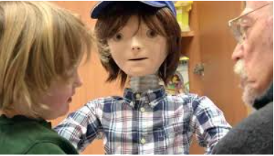
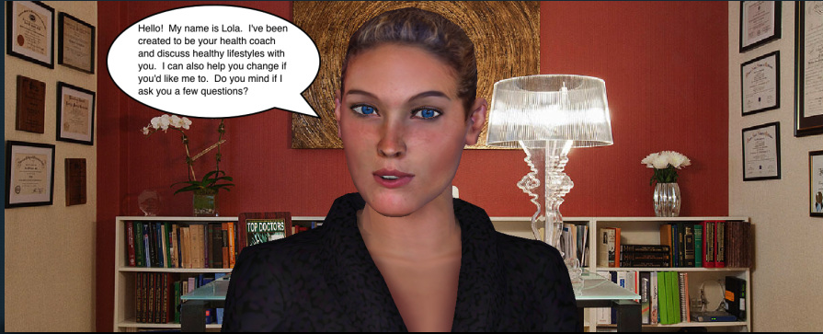
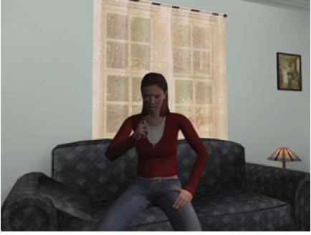
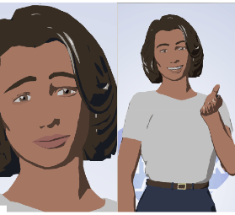
Various Forms & Complexity Levels: Social Robots & Virtual Agents
Social robot “Kaspar”
(Dautenhahn)
Virtual counselor “Lola”
(Lisetti)
Relational agent “Laura”
(Bickmore)
Virtual patient “Justina”
(Rizzo)
Notes:
We are ‘wired’ to build relationahips …. even with inanimate artifacts
Artificially intelligent
Can understand written & spoken language (somewhat)
Can carry on a conversation
Can display competence in a particular area
Affective
Can recognize human emotions
Can display appropriate emotion
Social & relational
Can interact in a socially-intelligent manner
Can build relationships with human users
Adaptive
Customize interaction to user’s state & needs
Conversational capabilities
Natural language understanding – very difficult!
BUT – restricted abilities go a long way
General competence
AI enables agents to display expert behavior – in restricted contexts
Emotional & social intelligence
Some human emotions recognized w/ high accuracy
Virtual agents & robots can display some emotions
Ability to form & maintain long-term relationships
We are ‘wired’ to form relationships
‘Relational agents’ being developed

Slide 6
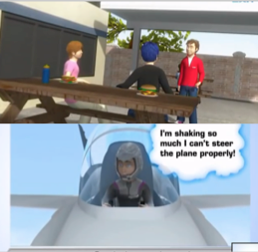
Serious Therapeutic Games
“Ricky the Spider” – OCD in Children (Brezinka)
“Secret Agent Society ” – Autism Spectrum Disorders (Beaumont)
Notes:
Conversational capabilities
Natural language understanding – very difficult!
BUT – restricted abilities go a long way
General competence
AI enables agents to display expert behavior – in restricted contexts
Emotional & social intelligence
Some human emotions recognized w/ high accuracy
Virtual agents & robots can display some emotions
Ability to form & maintain long-term relationships
We are ‘wired’ to form relationships
‘Relational agents’ being developed
Games _ we are wired to play
Serious affective games
Used for training & learning
Recognize & adapt to players’ emotions & learning needs
Game characters can display emotions
Game characters’ appearance & behavior match players’ individual & cultural preferences
Can the innate human propensity for play be leveraged to facilitate change & skill acquisition in therapy?
Emotional, cognitive, behavioral change
Therapeutic game for children with OCD
Dr. Veronika Brezinka, Zurich University
2300 users in 41 countries
Psycho-education about OCD (cognitive model)
Helps child create a hierarchy of symptoms
Teaches externalizing methods to cope with anxiety
Opportunities for exposure & practice of response-prevention
Secret Agent Society
Game for children on the autism spectrum
Social skills & emotion regulation
Dr. Renae Beaumont, Social Skills Training Institute, Australia
Benefits
Provide immersive affective experience
Provide engaging homework
Games don’t get tired or impatient
Games are inexpensive
Games are available 24/7 … anywhere

Slide 7
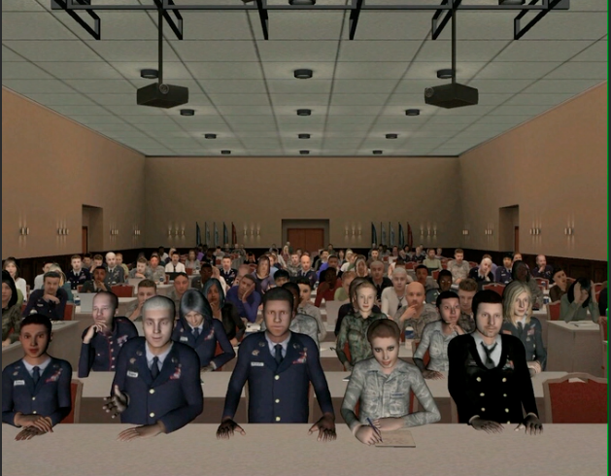
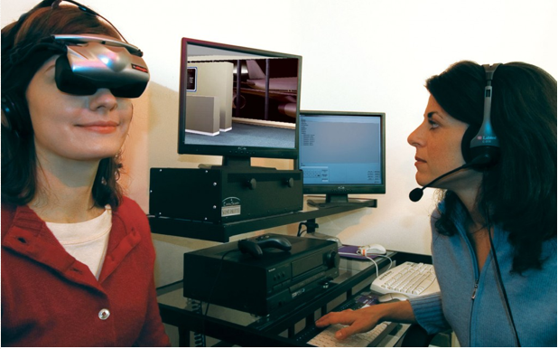
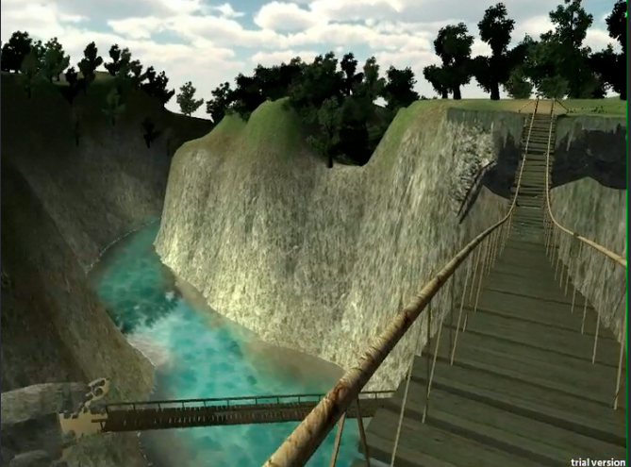
Virtual Reality
VR Treatment of Fear of Public Speaking (virtuallybetter.com)
VR Treatment of Fear of Heights (virtuallybetter.com)

Slide 8
Underlying Assumptions

Slide 9
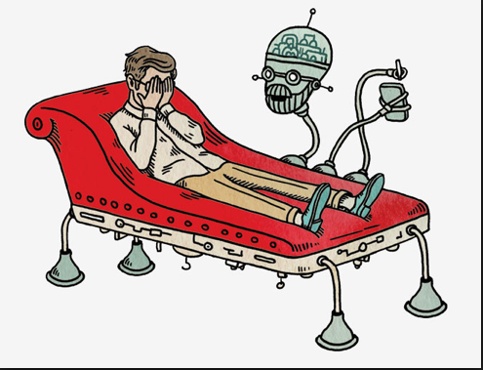
Behavioral Health Technologies
Adjuncts to traditional face-to-face treatment

Slide 10
Starting Assumptions
Technology is not a panacea
Human contact cannot be replaced
Too complex: cognitively & emotionally
But - technology has much to contribute
Adaptive, affective intelligent technologies exist today
Social agents & robots don’t get tired or impatient
Technology is available 24/7 & anywhere
Technology is not judgmental
Immersive, customizable, “fun” environments possible
Technology as an adjunct to face-to-face treatment

Slide 11
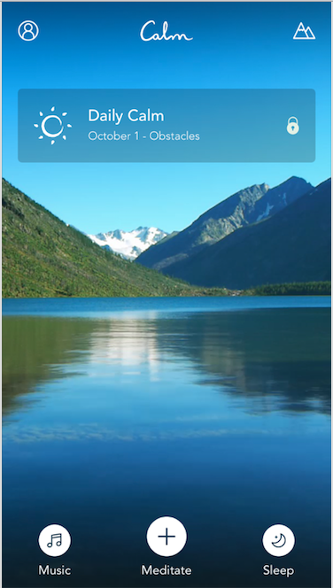
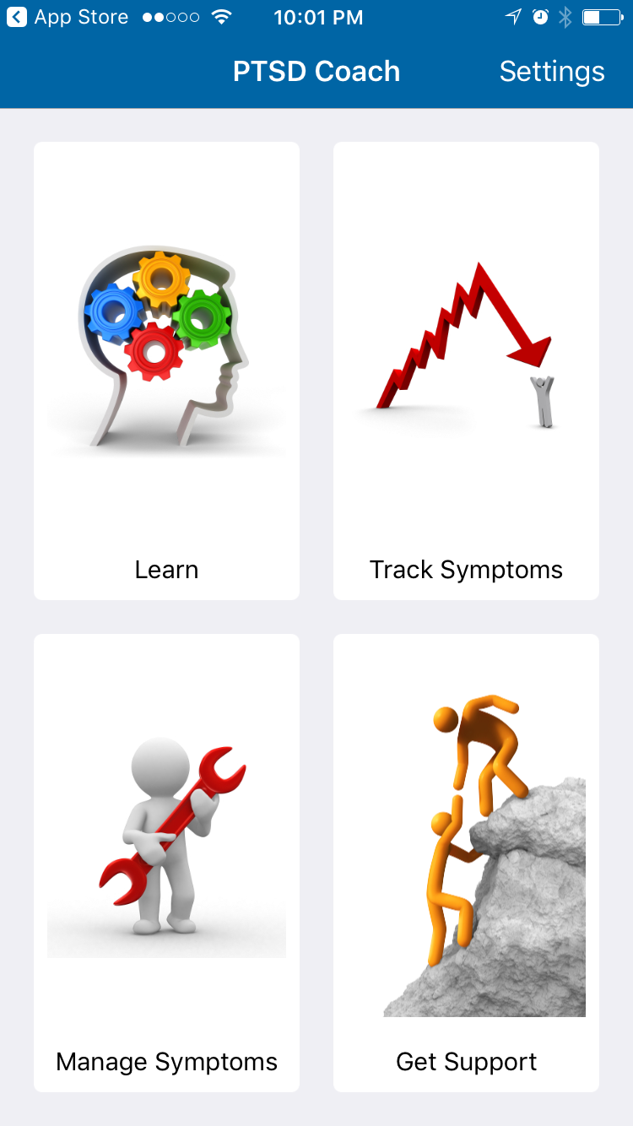
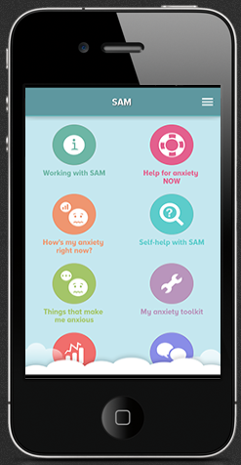
Mobile Apps for Behavioral Health
Mindfulness App
(calm.com)
PTSD Coach
(US Dept. of VA)
SAM – Anxiety Management (University of West England)

Slide 12
Mobile Mental Health Apps: State-of-the-Art Summary
Tens of thousands of apps available
Over 1500 for depression alone
Apps exist for a variety of disorders
Mood, anxiety, substance use , other addictive disorders, bi-polar disease, eating disorders, PTSD, ADHD…
Some apps support specific types of therapy
CBT, DBT, ACT…

Slide 13
Apps for Recovery
Sober grid – finds others in recovery (locally)
12 Steps AA companion – psycho-ed, encouragement, connect w/ others
AA Big Book – tracks sobriety, encouraging messages, “Big Book” text
A-CHESS – tracking, psychoed, communication w/ clinician
CassavaSM – meetings, sobriety score, daily reflections
SoberTool – tracks triggering thoughts / feelings, psycho-ed, tracks time & $ saved
Sobriety Counter – tracks moods, affirmations, meditation, social connection
Ascent – peer support via messaging, peer-recovery coaches

Slide 14
Mobile App Capabilities
Connect with others (peers, support, professionals)
Emergency contact (e.g., suicide hotline)
Information about nearby treatment programs
Psycho-education
Self-assessment of specific symptoms
Trigger identification
Symptom & behavior tracking
Symptom management
Set & manage goals

Slide 15
Shortcomings of Existing Apps
Few studies exist demonstrating effectiveness
Few apps offer evidence-based treatment
Most apps don’t incorporate available ‘advanced technologies’
Artificial intelligence
Affective computing
Social computing
Wearable technologies

Slide 16
Virtual Coach for Relapse Prevention

Slide 17
Virtual Coach Relapse Prevention App
Design & develop a mobile app to help prevent relapse in substance use
Incorporate some ‘advanced technologies’
Builds on prior work demonstrating effectiveness of virtual coaching (Hudlicka, 2013)
Conduct pilot RCT study to evaluate effectiveness in preventing relapse

Slide 18
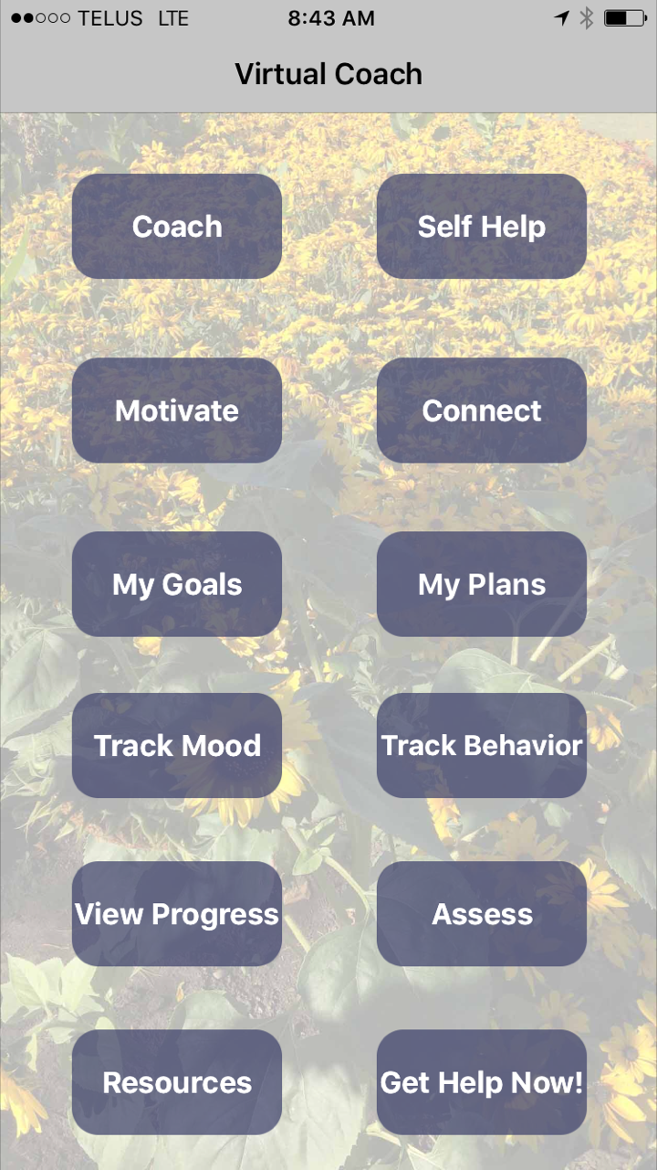

Slide 19
Relapse Prevention App: Primary Design Goals
Deliver evidence-based approach
Mindfulness-based relapse prevantion (MBRP)
Enhance engagement with treatment
Motivational interviewing (MI)
Self-determination theory (SDT)
Enhance engagement with app itself
Techniques from AI & Affective Computing
Virtual affective agent as coach
Dialogue in natural language
Customized training & coaching
Affect-adaptive interaction
Gamification
Notes:
Deliver evidence-based approach
Mindfulness-based relapse prevention (Marlatt)
Reduction in cravings & reactivity; increase in distress tolerance
5 weeks of training + coaching
Assess progress via established instruments (AWARE, PACS)
Enhance engagement with treatment
Motivational interviewing (Miller & Rollnick)
Client-centered; collaborative; works w/ ambivalence
Self-determination theory (Ryan & Deci)
Autonomy, competence, relatedness
Use techniques from AI & affective computing
Virtual affective agent as a coach
Dialogue in natural language
Customized training & coaching
Affect-adaptive interaction
Gamification

Slide 20
Available Functions
Training & Coaching in MBRP
Delivered via dialogue w/ virtual coach character
Affect-adaptive; relational
Goal Setting
Motivation (MI, SDC)
Mood & cravings tracking
Behavior tracking
Progress assessment (formal instruments & informal)
Connection w/ others (peers, clinicians)
Resources

Slide 21
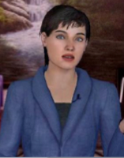
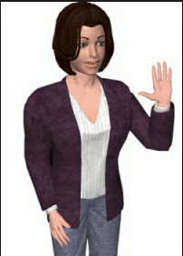
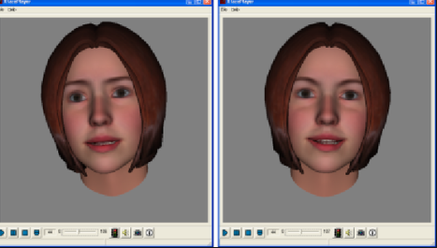
Possible Coach Embodiments

Slide 22
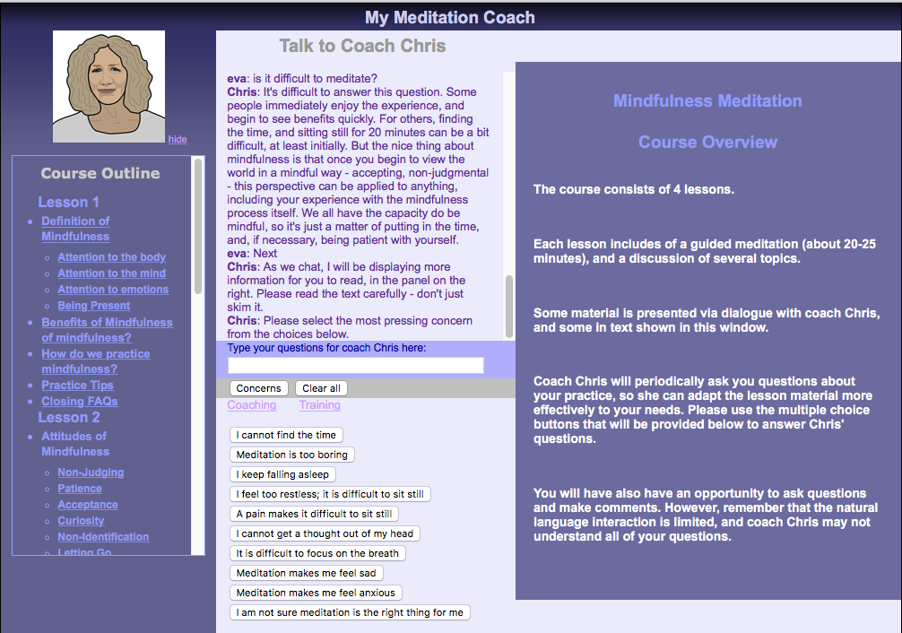

Slide 23
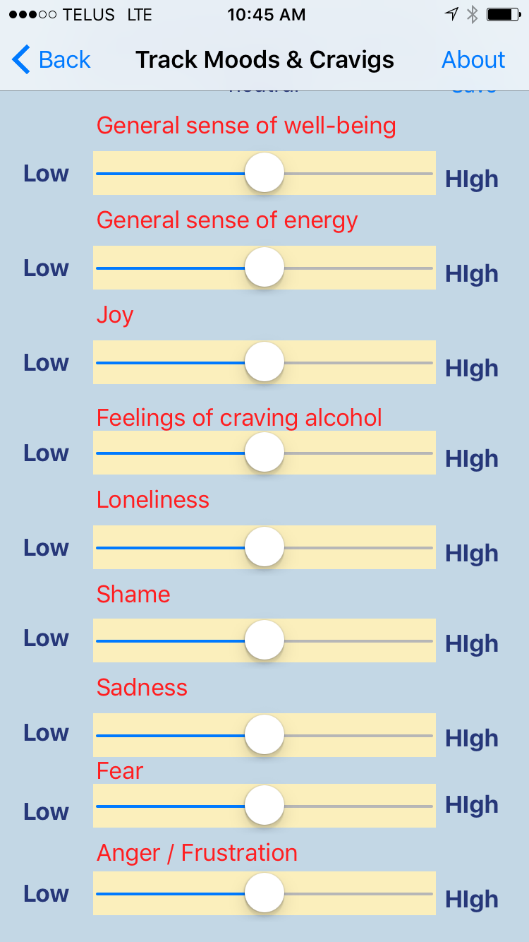
Symptom & Emotion Tracking

Slide 24
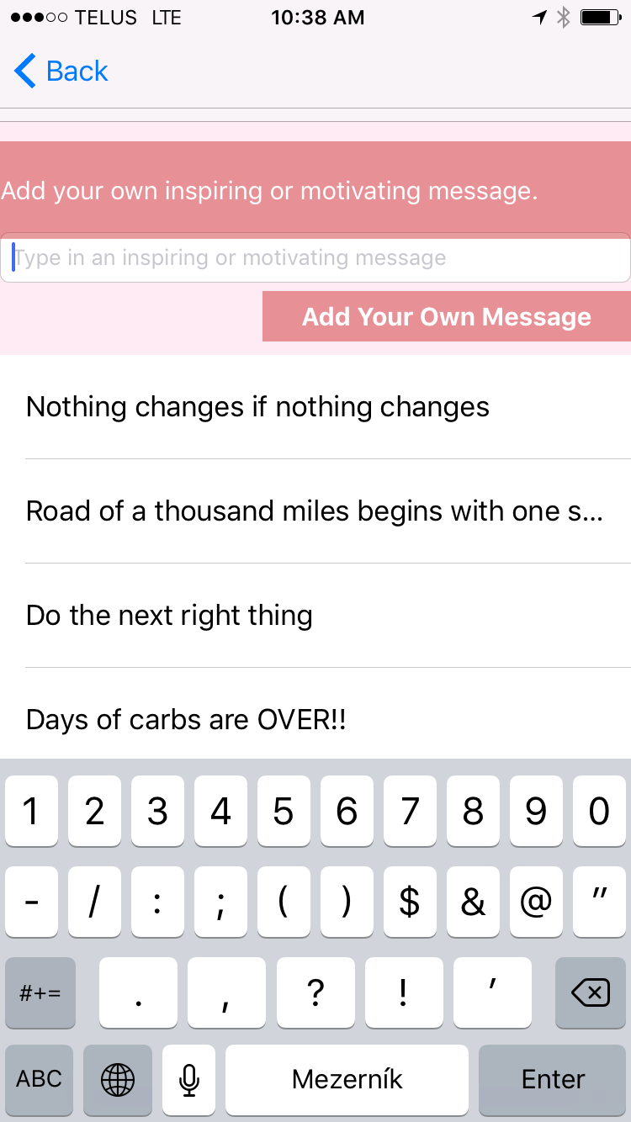
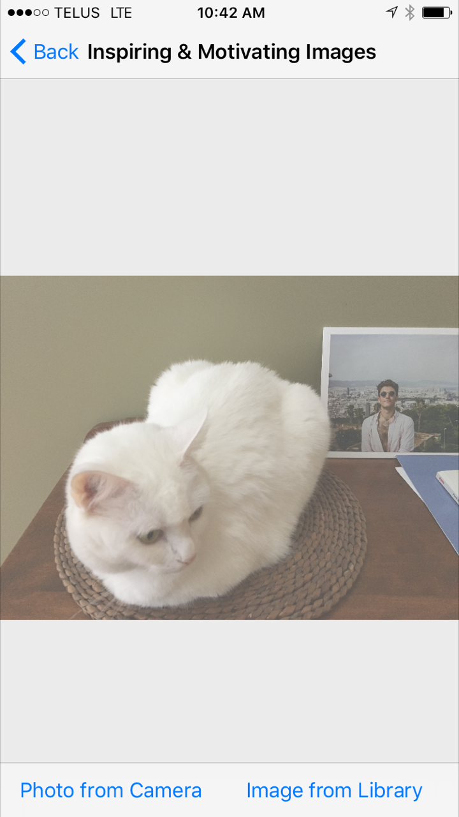
Customization

Slide 25
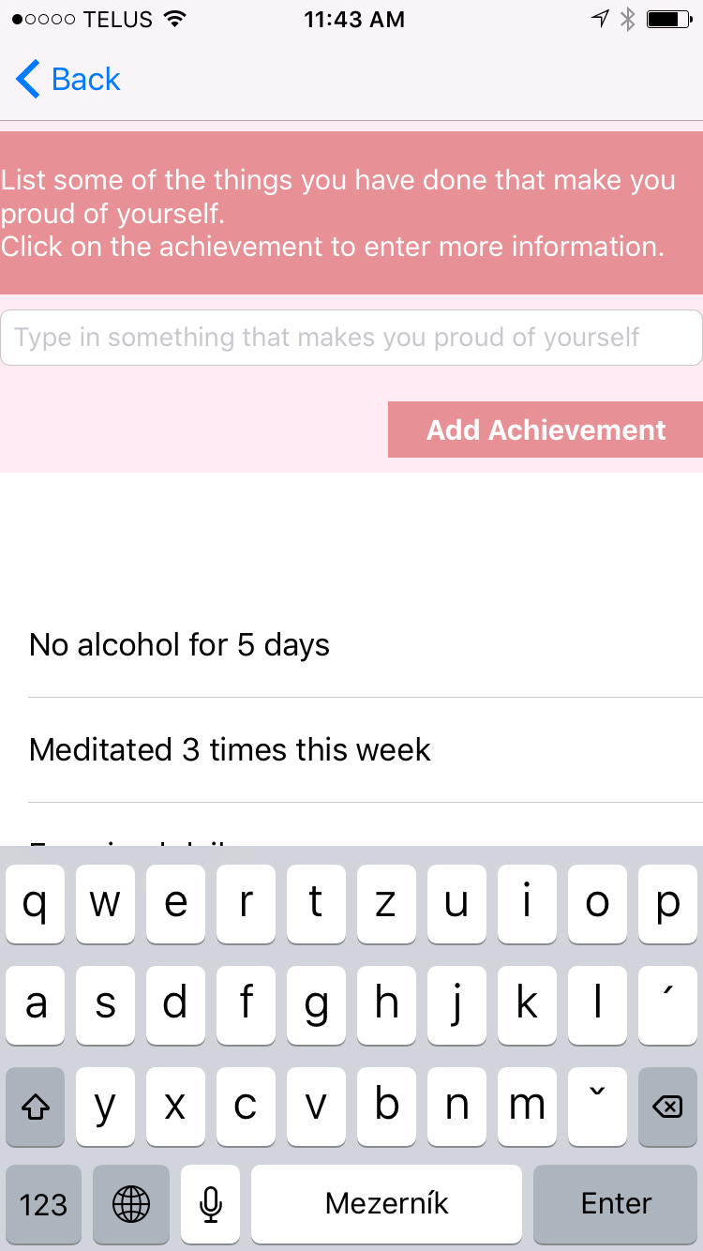
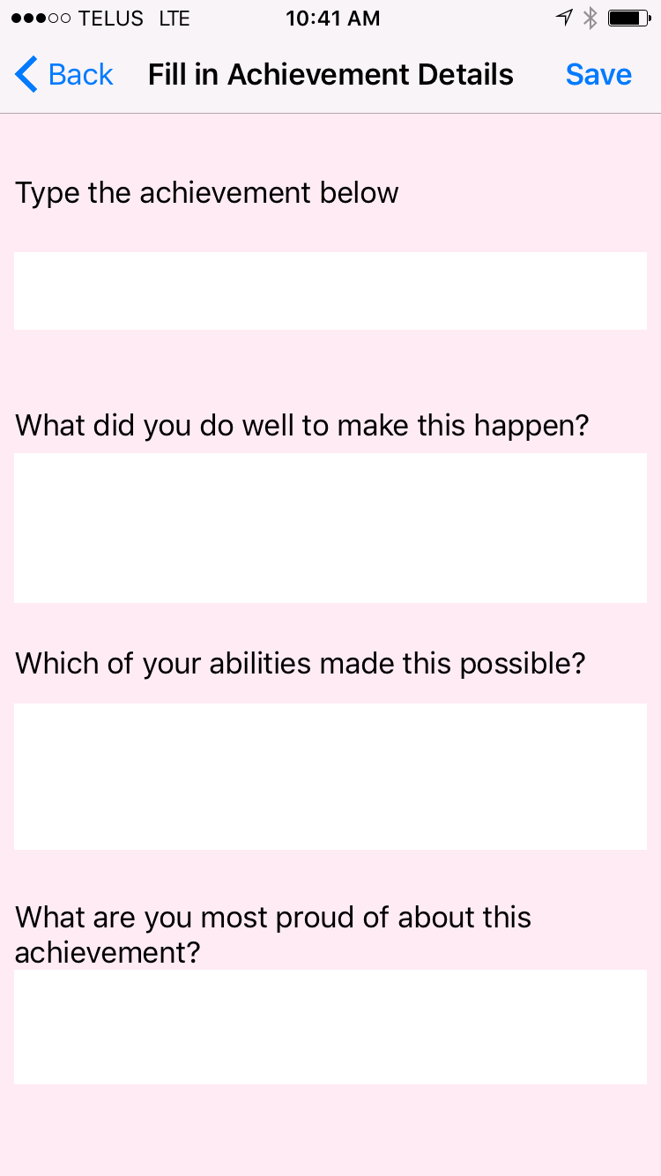
Focus on Strengths - Competence

Slide 26
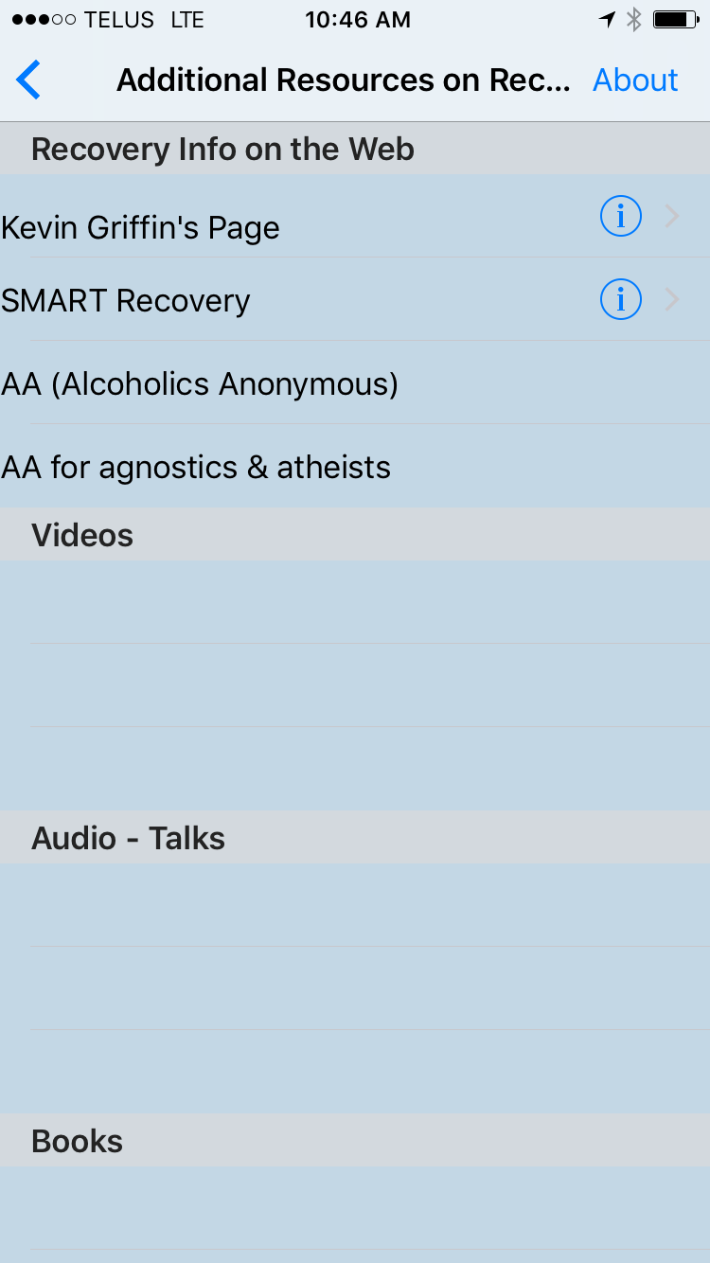
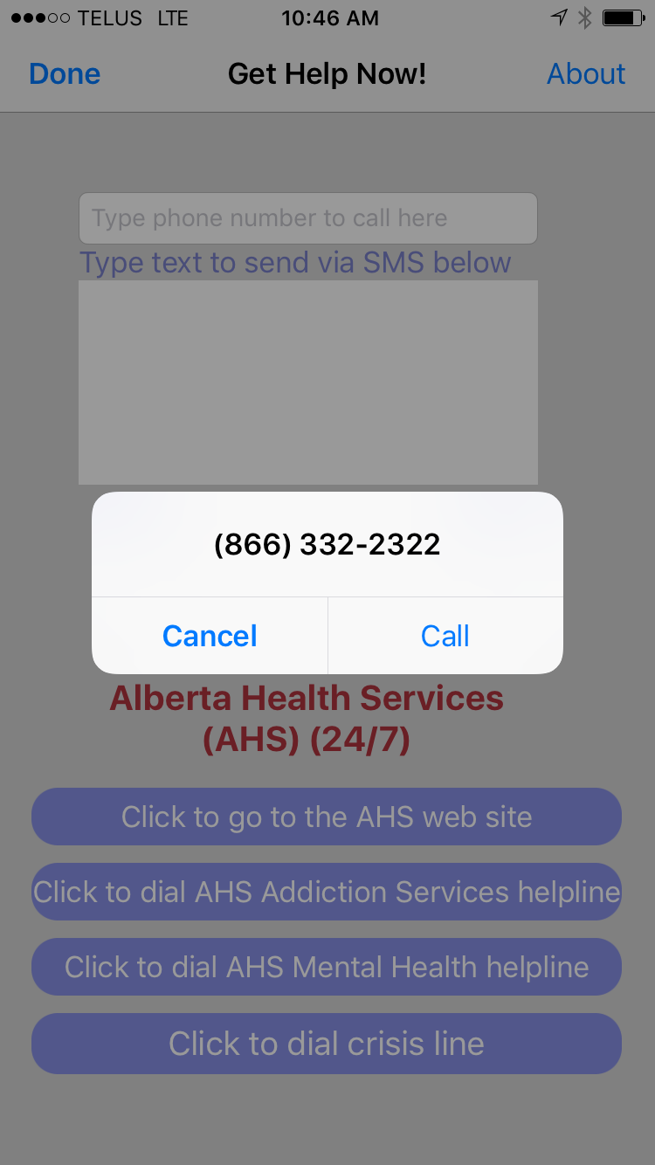
Access Resources & Get Help Now

Slide 27
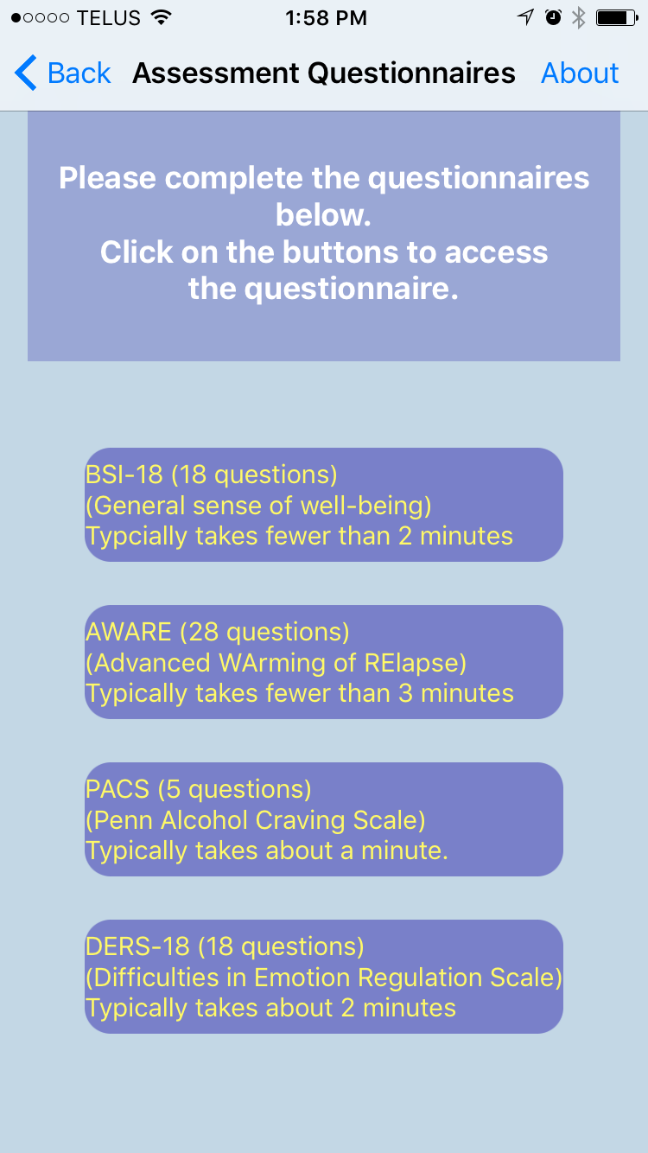
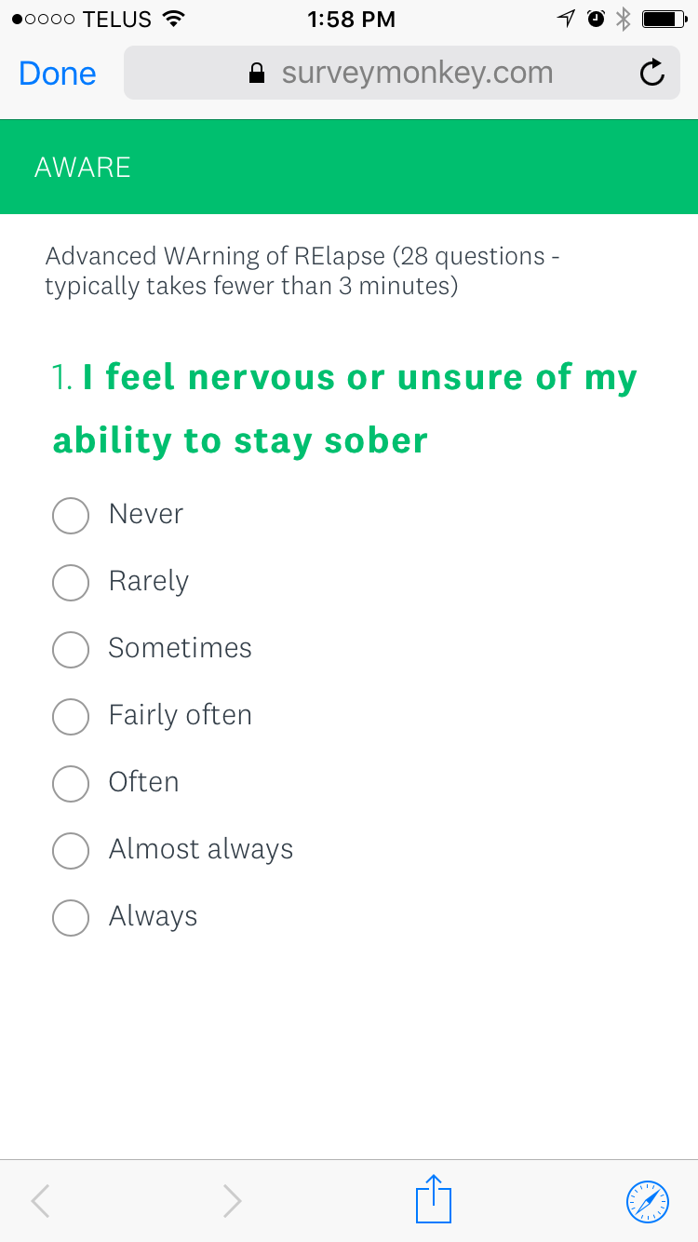
Integrated Formal Assessment

Slide 28
Benefits of Behavioral Technologies
Access
Anytime / anywhere
Low cost
When traditional treatment not available
Waiting period; rural area
When stigma & symptoms interfere
Symptom & trigger tracking
View trends, progress
Share data w/ others (peers, clinicians)
Support between sessions
Homework / Practice
Applicable to all stages of treatment

Slide 29
Risks
Privacy concerns – misuse & loss of private data
Some apps may sell users’ data
Google is everywhere…
Self-diagnosis
Reliance on app (& not seeking professional help)
Provides wrong or dangerous advice
e.g., use of alcohol for individuals in a manic episode
Make unsubstantiated claims about ability to help
Wastes person’s time
May make person feel they are ‘beyond help’

Slide 30
Issues in Adoption of Technologies
Awareness of how technology may help
Awareness of existing systems & “apps”
Orienting within the (overwhelming) “app marketplace”
Which app to recommend?
What criteria to use to evaluate?
Cultural mindset
Individual (clinicians, clinic directors)
Organizational
Encouragement to integrate apps into treatment
Education & training
Assumptions about available technologies
Ineffective? Panacea? Threat? Lack of evidence? ???

Slide 31
How to Evaluate Apps?
RCT study evaluation data exist (unlikely)
Evaluated via emerging rating scales (e.g. MARS)
Experts recommend
Users recommend (e.g., AA)
Anecdotal positive evidence
Client / patient likes it
Availability & cost

Slide 32
Examples of rating scales
MARS (Stoyanov et al. 2015)
ASPECTS (Torous et al., 2016)
APA scale (Am. Psychiatric Association)
IMART (Maheu et al., 2016)
Most criteria focus on usability & privacy
E.g., MARS offers 19 criteria - only one assesses evidence
Notes:
ASPECTS
Actionable, Secure, Professional, Evidence Based, Customizable, TransParent
Stoyanov et al.

Slide 33
Do We Need to Rethink the RCT “Gold Standard”? … for mobile apps

Slide 34
Is There a Need for a Change in Mindset?
Ideally, all mental health apps evaluated via RCT studies
This will not happen – technology moves too fast
Is there a middle ground?
Can we identify criteria for app adoption that:
Relax the RCT “gold standard”
Yet maintain safety for clients & general public
… to make these technologies accessible to a wider population who could benefit
Is the perfect the enemy of the good?

Slide 35
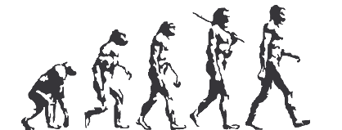
In terms of the full potential of technologies for Behavioral Health…
We Are About Here…

Slide 36
Conclusions
Potential of behavioral health tech to transform treatment
Strategies for mitigating risks necessary
Cross-disciplinary collaborations necessary
Need for rapid evaluation of effectiveness
Need for development of new criteria for ‘evidence-based’

Slide 37
Additional Materials
therapy 21st.net
https://people.cs.umass.edu/~hudlicka/pubs.html

Slide 38
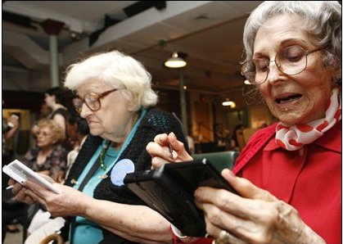
Thank you
Questions?

Slide 39
Discussion Groups
5 groups
Researchers
Practitioners
Policy-makers
People with lived experience
Anyone
Two questions:
Hindrances to adopting mobile apps in treatment
Criteria for ‘evidence based’ when RCT not feasible?
Designated note taker
Report by group ( ~ 3’)
Notes:
Addressing two questions: (leave up so don’t have to write it down)
- Hindrances to adoption of mobile apps in addiction treatment
(assuming different risks identified in different groups)
- Assuming RCT studies not feasible for majority of apps – what criteria do we use for adoption?
Designated note taker
Report by group of top 3
Last slide before group
Would like to form an e -working group on this, if interested, please email me
Two questions

Slide 40
Questions
Hindrances to adopting mobile apps in treatment
Criteria for ‘evidence based’ when RCT not feasible?

